Slide 1
Reporter Online Training Housekeeping
All participants will be muted upon joining the training due to the large class size.
Please use the chat feature to ask any questions.
If you require closed captioning, you can turn it on by clicking on the three dots (more), scroll down to CC. Once you click on CC the closed captioning will be on. Some of our presenters will be close captioning their presentations.

Slide 2
Disclaimer
These training materials are offered in a training scenario to serve as guidance to assist in reporting, paying, or determining value for royalties. Because reporting, payment, and valuation circumstances vary from lessee to lessee, be advised that these training materials may not precisely reflect your scenario. Accordingly, these general materials should not be construed as setting binding or enforceable policy.
Reliance on this guidance does not prohibit ONRR from future compliance activities or auditing of your reporting based on your use of the information contained within or from directing you to report and pay in a different manner based on an application of federal law to your unique factual circumstances. These training materials do not constitute an appealable decision or order under 30 C.F.R. 1290, Subpart B. If you have any questions, please use the contact information identified in this presentation or visit https://onrr.gov/about/contact.

Slide 3
Commonly Used
Transaction Codes

Slide 4
2014 Commonly Used Transaction Codes
Royalty Due 01
Minimum Royalty 02
Rent (non-recoupable) 04
Rent (recoupable) 05
Rent Recoupment 25
Estimate Reporting 03

Slide 5
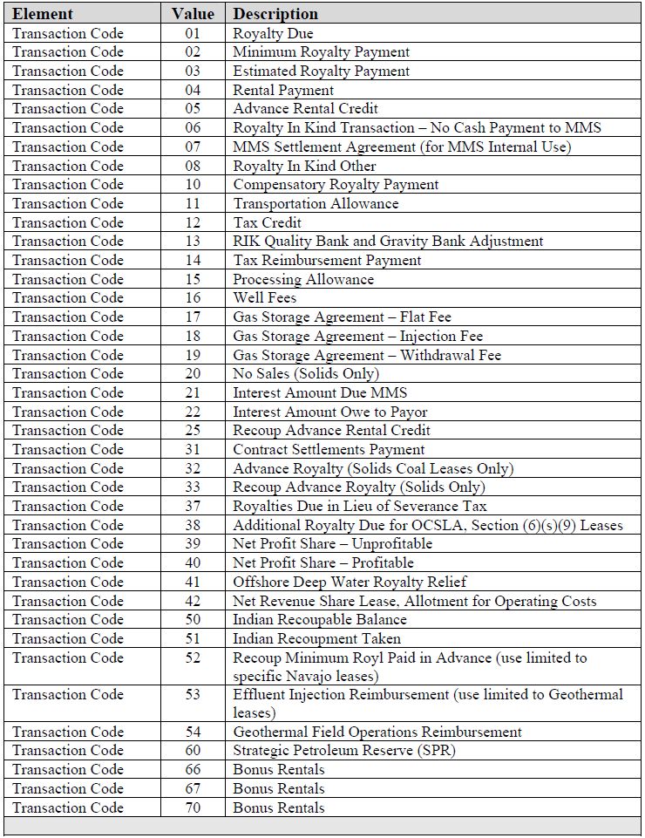
2014
Transaction Codes

Slide 6
Transaction Code 01 Royalty Due
Due Monthly on every lease or lease-agreement combination with sales
Separate line for each lease or lease agreement combination, sales type code, product code, and sales month
If reporting an adjustment, it must be a double entry on the report

Slide 7
Transaction Code 01
Detail Line
Line Number 1
API Well Number
ONRR Lease Number 0490129432
ONRR Agreement Number
Product Code 01
Sales Type Code ARMS
Sales MO/YR 022015
Transaction Code 01
Adjustment Reason Code
Sales Volume 1280.00
Gas MMBtu 0.00
Sales Value 704.00
Royalty Value Prior to Allowances 88.00
Transportation Allowance 0.00
Processing Allowance 0.00
Royalty Value Less Allowances 88.00
Payment Method Code 3

Slide 8
Implied Relationships
Royalty Value PA 2747.00 = Royalty Rate = .125 Sales Value 21975.00
Monitored for royalty rate verification
Sales Value 21975.00 = Price Per Unit = Sales Volume 439.50 $50.00
Monitored for reasonable pricing

Slide 9
Lease Level Payments
TC 02 Minimum Royalty (MR)
TC 03 Estimates
TC 04 Rent (non-recoupable)
TC 05 Rent (recoupable)
TC 25 Recouping Advance Rent
Payments are based on lease terms
Do not report the agreement number, product code, or sales type code
Do not report the sales volume or sales value since they are not associated with these types of payments

Slide 10
Transaction Code 02 Minimum Royalty (MR)
Due on producing Federal and Indian leases
Obligation may be fulfilled by production
Report and payment must be received on or before the last day of the lease year, regardless of an estimate
Automatically invoiced if not paid or reported incorrectly with the wrong sales month/year

Slide 11
Transaction Code 02 (Minimum Royalty)
Detail Line
Line Number 1
API Well Number
ONRR Lease Number 0490129432
ONRR Agreement Number
Product Code
Sales Type Code
Sales MO/YR 062015
Transaction Code 02
Adjustment Reason Code
Sales Volume
Gas MMBtu 00
Sales Value
Royalty Value Prior to Allowances 88.00
Transportation Allowance
Processing Allowance
Royalty Value Less Allowances 88.00
Payment Method Code 03
It is important to make sure you are using the correct sales month when reporting minimum royalty

Slide 12
Rental Payments
Rental payments for terminable leases MUST be reported and paid using the Online Rental Payment System (ORPS)
ORPS is an all-in-one platform that satisfies both payment AND reporting requirements
ORPS training is available in the eCommerce Tools module
For non-terminable leases, ONRR automatically invoices if not paid

Slide 13
Transaction Code 04 (Non-recoupable Rent)
Detail Line
Line Number 1
API Well Number
ONRR Lease Number 0490129432
ONRR Agreement Number
Product Code
Sales Type Code
Sales MO/YR 072015
Transaction Code 04
Adjustment Reason Code
Sales Volume
Gas MMBtu
Sales Value
Royalty Value Prior to Allowances 345.00
Transportation Allowance
Processing Allowance
Royalty Value Less Allowances 345.00
Payment Method Code 3

Slide 14
Transaction Code 05 (Recoupable Rent)
Detail Line
Line Number 1
API Well Number
ONRR Lease Number 0490129432
ONRR Agreement Number
Product Code
Sales Type Code
Sales MO/YR 072015
Transaction Code 05
Adjustment Reason Code
Sales Volume
Gas MMBtu
Sales Value
Royalty Value Prior to Allowances 345.00
Transportation Allowance
Processing Allowance
Royalty Value Less Allowances 345.00
Payment Method Code 3

Slide 15
Transaction Code 25 (Recouping Advance Rental Credits)
Use in conjunction with TC 05
Recoup against current revenue
Rent can be recouped up to 100% of current revenue within the current lease year regardless of whether the lease is allotted or tribal (rent must be reported and paid)

Slide 16
Transaction Code 25 (Rent Recoupment)
Detail Line
Current Prod Rental Recoup
Line Number 1 2
API Well Number
ONRR Lease Number 0490129432 0490129432
ONRR Agreement Number
Product Code 01
Sales Type Code ARMS
Sales MO/YR 082015 082015
Transaction Code 01 25
Adjustment Reason Code
Sales Volume 9.06
Gas MMBtu
Sales Value 704.00
Royalty Value Prior to Allowances 88.00 -88.00
Transportation Allowance
Processing Allowance
Royalty Value Less Allowances 88.00 -88.00
Payment Method Code 3 3

Slide 17
What is an Estimate?
An estimate is a one-time payment in lieu of an actual royalty payment
An estimate gives you an additional month to report
Royalties are then due on the last day of the second month product was sold or removed from the lease
Must be reported on the lease level

Slide 18
Estimate Reporting (cont.)
Why establish an estimate?
Gives an additional month to report and pay actual royalties
May help reduce late payment interest charges
Estimate reporting may be beneficial and helpful if sales data is not received timely to report to ONRR

Slide 19
How an Estimate Works
First report month:
Report and pay the one-time estimate payment in lieu of a royalty payment for that month
Then in subsequent months:
Report and pay the actual royalties
Royalties are now due on or before the last day of the second month following the month the product was sold or removed from the lease

Slide 20
How To Determine The Amount Of an Initial Estimate Payment
Companies should establish their estimate in an amount which equals or exceeds the average monthly royalty liability for the LEASE and PRODUCT
Adjust the estimate balance up or down as the lease royalty liability changes

Slide 21
Transaction Code 03 (Establishing a First-Time Estimate)
Detail Line
Line Number 1
API Well Number
ONRR Lease Number 0490129432
ONRR Agreement Number
Product Code
Sales Type Code
Sales MO/YR 022015
Transaction Code 03
Adjustment Reason Code
Sales Volume
Gas MMBtu
Sales Value
Royalty Value Prior to Allowances 88.00
Transportation Allowance
Processing Allowance
Royalty Value Less Allowances 88.00
Payment Method Code 3
Sales month on the estimate line must be one month prior to the report month (in lieu of royalties)
An adjustment reason code is not required when establishing an estimate for the first-time.

Slide 22
How to Change the Amount of an Estimate
Use a single line entry in the 2014 report to increase or decrease the amount of an estimate
Use transaction code 03 with adjustment reason code 32

Slide 23
Transaction Code 03 (Increasing an Estimate)
Detail Line
Line Number 1
API Well Number
ONRR Lease Number 0490129432
ONRR Agreement Number
Product Code
Sales Type Code
Sales MO/YR 062014
Transaction Code 03
Adjustment Reason Code 32
Sales Volume
Gas MMBtu
Sales Value
Royalty Value Prior to Allowances 100.00
Transportation Allowance
Processing Allowance
Royalty Value Less Allowances 100.00
Payment Method Code 3

Slide 24
How to Recoup an Estimate
Recoup Federal estimates anytime
Recoup Indian estimates according to Indian recoupment limitations (estimate payments are overpayments, not required by terms)
Estimate payments are disbursed by ONRR to the entitled recipients

Slide 25
Transaction Code 03 (Decreasing an Estimate)
Detail Line
Line Number 1
API Well Number
ONRR Lease Number 0490129432
ONRR Agreement Number
Product Code
Sales Type Code
Sales MO/YR 062014
Transaction Code 03
Adjustment Reason Code 32
Sales Volume
Gas MMBtu
Sales Value
Royalty Value Prior to Allowances -100.00
Transportation Allowance
Processing Allowance
Royalty Value Less Allowances - 100.00
Payment Method Code 3

Slide 26
An estimate is NOT needed for all products
The estimate sales month will reflect all products on the lease.
Companies need to use the correct sales month for any product not requiring an estimate

Slide 27
Transaction Code 03 1of 3 (Multiple Products and Establishing an Estimate)
Detail Line
Current Prod Estimate for Gas
Line Number 1 2
API Well Number
ONRR Lease Number 0490129432
ONRR Agreement Number
Product Code 01
Sales Type Code ARMS
Sales MO/YR 022015
Transaction Code 01
Adjustment Reason Code
Sales Volume 9.06
Gas MMBtu
Sales Value 704.00
Royalty Value Prior to Allowances 88.00
Transportation Allowance
Processing Allowance
Royalty Value Less Allowances 88.00
Payment Method Code 03
Situation: Lease has oil and gas sold for the month of February. Payor only receives the sales data for oil by the report due date

Slide 28
Transaction Code 03 2 of 3 (Multiple Products and Establishing an Estimate)
Detail Line
Current Prod Estimate for Gas
Line Number 1 2
API Well Number
ONRR Lease Number 0490129432 0490129432
ONRR Agreement Number
Product Code 01
Sales Type Code ARMS
Sales MO/YR 022015 022015
Transaction Code 01 03
Adjustment Reason Code
Sales Volume 9.06
Gas MMBtu
Sales Value 704.00
Royalty Value Prior to Allowances 88.00 1,000.00
Transportation Allowance
Processing Allowance
Royalty Value Less Allowances 88.00 1,000.00
Payment Method Code 03 03

Slide 29
Transaction Code 03 3 of 3 (Multiple Products and Establishing Estimate)
Detail Line
Oil Prod Gas Prod Inc Gas Est
Line Number 1 2 3
API Well Number
ONRR Lease Number 0540077770 0540077770 0540077770
ONRR Agreement Number
Product Code 01 04
Sales Type Code ARMS ARMS Sales MO/YR 022015 012015 022015
Transaction Code 01 01 03
Adjustment Reason Code 32
Sales Volume 9.06 3020.00
Gas MMBtu 3624.00
Sales Value 704.00 18120.00
Royalty Value Prior to Allowances 88.00 2265.00 500.00
Transportation Allowance
Processing Allowance
Royalty Value Less Allowances 88.00 2265.00 500.00
Payment Method Code 3 3 3
Once a payor has established an estimate for a lease, they need to make sure they report the correct sales month and adjust their estimate accordingly

Slide 30
The ONRR Financial System uses estimate balances in late payment interest calculations
The ONRR financial system tracks estimate balances
For a given lease and sales month, the ONRR financial system compares the lease estimate balance to the actual royalty paid under the estimate
Interest is due on the amount that the royalty payment exceeds the estimate balance
Interest is also due on amounts paid after the due date for estimate reporting.

Slide 31
Maintain Estimate Balance Records
The 2014 estimate balance report summarizes ONRR’s records of estimate transactions.
Companies can access this monthly report in the Web Center Portal under Payor Estimate Balance report.
Companies should keep a record of their estimate payments by lease and reconcile balances at least yearly

Slide 32
Thank you for attending

