Slide 1
Disclaimer
This presentation is guidance and not binding on ONRR. It does not provide legal advice and should not be construed as stating ONRR’s legal interpretation or position. Any reliance on this presentation does not limit ONRR in its compliance activities or in the appealable decisions and orders it may issue.

Slide 2
Overlapping Unit and Communitization Agreements
Matthew Fields
Data Intake, Validation, and Indian Coordination

Slide 3
Objectives
Explain what an Overlap is and identify the main components
Discuss the new Overlap policies released by BLM and what they mean to the future of Overlaps
Complete two overlaps under the new North Dakota BLM policy, including:​
Mapping the Communitization Agreement (CA) overlap​
Completing the royalty report (Form ONRR-2014) for the CA overlap

Slide 4
Agreement Overlaps1

Slide 5
Agreement Overlaps2
An Agreement Overlap is when land of any type (Federal, Indian, Fee or State) is in more than one agreement and the same formation and the land overlaps each other.
Total Overlap – CA is completely overlapping an Agreement(s).
If a CA completely overlaps more than one Agreement the OGOR reporting stays with the New CA, and the 2014’s are submitted on the agreements the CA overlaps.
Partial Overlap – CA is partially within the Agreement
OGORs: Each Agreement will report it’s own Production.
ONRR-2014: CA production allocated to the overlapped portion of the CA is then reallocated to the Overlapped Agreement in accordance with that Agreements allocation schedule.

Slide 6
The Future of Overlaps
Issued July 3, 2018
BLM and BIA have implemented a new policy changing how CA overlaps are done (BLM Permanent Instruction Memorandum No. 2018-012). This policy was issued July 3, 2018 and applies to any CA that has an effective date after the IM’s issue date. This only applies to CA’s that overlap an existing CA. This Instruction Memorandum can be found on BLM’s website.
BLM/BIA will approve a new CA when the CA overlaps an existing CA(s) ONLY when the new CA will allocate production and associated royalties from the new CA directly to the leases within the boundary of the new CA.
BLM/BIA will continue to follow the existing policy when processing a new CA that would partially overlap an existing Participating Agreement for the same formation within an approved Federal or Indian exploratory oil and gas unit.

Slide 7
What does this mean?
When approving a new CA that overlap’s an existing CA, BLM/BIA will no longer allocate production and associated royalties from the new CA to the existing underlying CA(s) that the new CA overlaps.
Each new CA will be a “Stand-Alone” agreement and will not change the allocation of production or associated royalties for the underlying CA.
There will be no reference to an Overlap in the letter or on the SRP. Royalty reporting is based on the lease-to-agreement allocation for all production. 2014’s will be submitted with both the lease and agreement numbers.

Slide 8
North Dakota IM
North Dakota issued a Supplement IM to the new BLM/BIA policy on July 27, 2018; PIM 2018-004.
This IM applies to any CA approved after July 27, 2018. This Instruction Memorandum can be found on BLM’s website.
North Dakota will continue to allocate to overlapped Base CA’s that are within the boundary of the new CA.
When a new CA overlaps an existing overlapping CA the agencies will NO LONGER further allocate out to existing overlapping CA’s that are not within the boundary of any Base CA.

Slide 9
Oil and Gas Reporting
OGOR – All production is reported on the source agreement.
ONRR-2014 – CA production allocated to the portion overlapping another agreement is then reallocated to that overlapped agreement in accordance with the overlapped agreements allocation schedule.
New Overlap Policy - issued July 3, 2018 and applies to any CA with an EFFECTIVE date after the issue date.
ND Overlap Policy - issued July 27, 2018 and applies to any CA with an APPROVAL date after the issue date.

Slide 10
Partial Overlap Example
200 Bbls from CA2
Reallocate to CA1
CA 1
Tract 1 = 50%
Tract 2 = 50%
Tr 1 = 100 Bbls
Tr 2 = 100 Bbls
CA 2
800 Bbls
produced & sold
From CA 2
Tract 1 = 25%
Tract 2 = 25%
Tr 1 = 200 Bbls
Tr 2 = 200 Bbls
Tr 3 = 200 Bbls
Tr 4 = 200 Bbls
Tract 3 = 25%
Tract 4 = 25%

Slide 11
Total Overlap Example
400 Bbls from CA 3
Reallocate to CA 1
400 Bbls from CA 3
Reallocate to CA 2
Tr 1 = 200 Bbls
Tr 2 = 200 Bbls
Tr 1 = 200 Bbls
Tr 2 = 200 Bbls
CA 1
CA 3
CA 2
Tract 1 = 50%
Tract 2 = 50%
Tract 1 = 50%
Tract 2 = 50%
800 Bbls
produced & sold
From CA 3
Tract 1 = 25%
Tract 2 = 25%
Tr 1 = 200 Bbls
Tr 2 = 200 Bbls
Tr 3 = 200 Bbls
Tract 3 = 25%
Tract 4 = 25%
Tr 4 = 200 Bbls

Slide 12
Partial Overlap-New ND IM Example
CA 1
200 Bbls from CA 4
Reallocate to CA 1
Tract 1 = 50%
Tract 2 = 50%
Tr 1 = 100 Bbls
CA 3
Tr 2 = 100 Bbls
CA 4
800 Bbls
produced & sold
from CA 4
Tract 1 = 25%
Tract 2 = 25%
Tr 1 = 200 Bbls
CA 2
Tr 2 = 200 Bbls
Tr 3 = 200 Bbls
Tr 4 = 200 Bbls
Tract 3 = 25%
Tract 4 = 25%

Slide 13
Total Overlap-New ND IM Example
400 Bbls from CA 5
Reallocate to CA 2
400 Bbls from CA 5
Reallocate to CA 3
Tr 1 = 200 Bbls
Tr 2 = 200 Bbls
Tr 1 = 200 Bbls
Tr 2 = 200 Bbls
Tract 1 = 50%
Tract 1 = 50%
Tract 1 = 50%
CA 5
CA 1
CA 2
CA 3
800 Bbls
produced & sold
From CA 5
Tract 1 = 25%
Tract 2 = 25%
Tract 2 = 50%
Tract 2 = 50%
Tract 2 = 50%
Tr 1 = 200 Bbls
Tr 2 = 200 Bbls
Tr 3 = 200 Bbls
Tract 3 = 25%
Tract 4 = 25%
Tr 4 = 200 Bbls
CA 4

Slide 14
Overlap Example 1

Slide 15
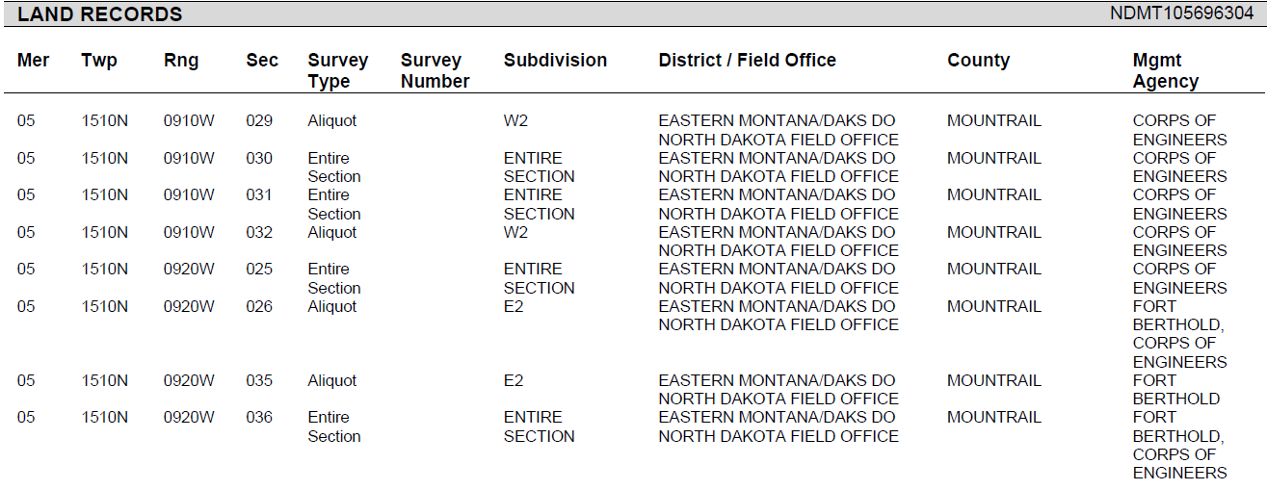
Example Overlap NDM110534 (1 of 2)

Slide 16
Example Overlap NDM110534 (2 of 2)

Slide 17
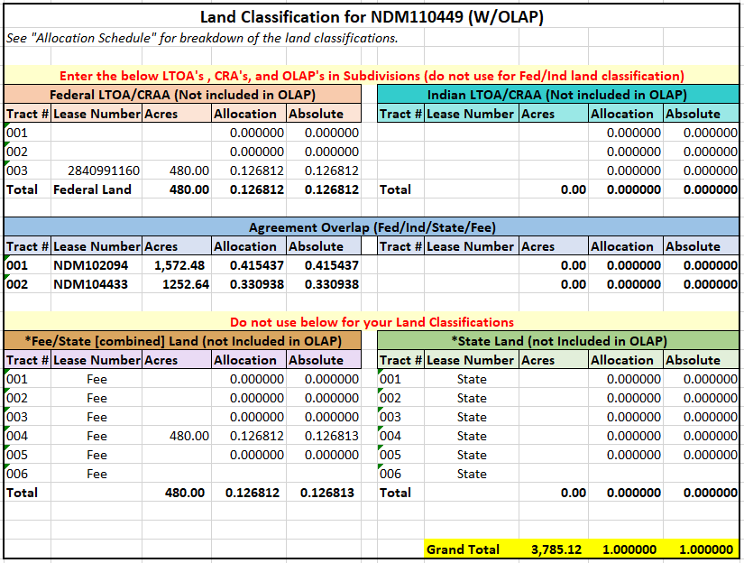
Allocation Breakdown for CA NDM110534

Slide 18
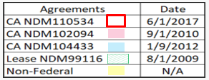
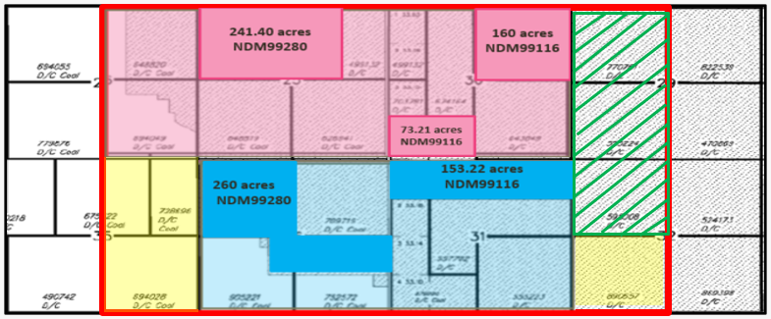
Map for NDM110534

Slide 19
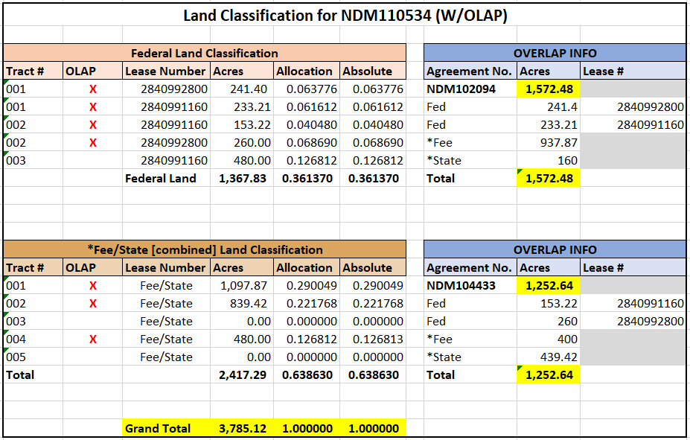
Land Classification Allocation Breakdown for NDM110534

Slide 20
Reporting for Overlap Example 1

Slide 21
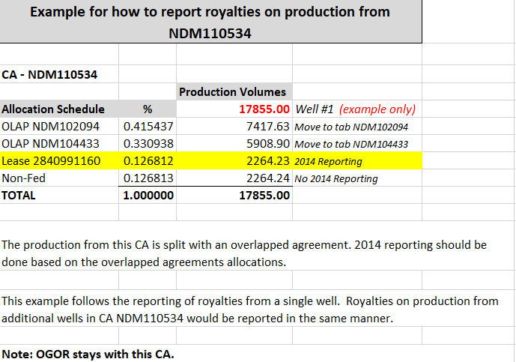
Reporting Example for NDM110534 (1 of 4)

Slide 22
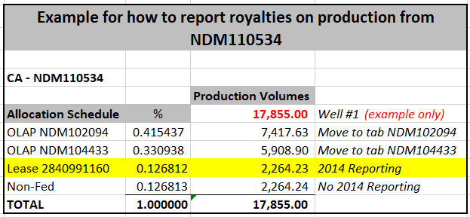
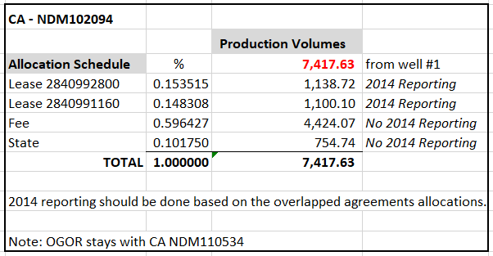
Reporting Example for NDM110534 (2 of 4)
1st CA NDM102094 in Overlap

Slide 23
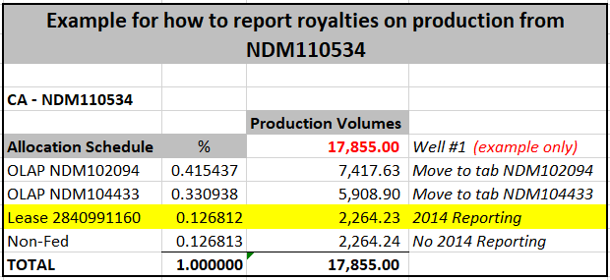
Reporting Example for NDM110534 (3 of 4)
2nd CA NDM104433 within Overlap

Slide 24
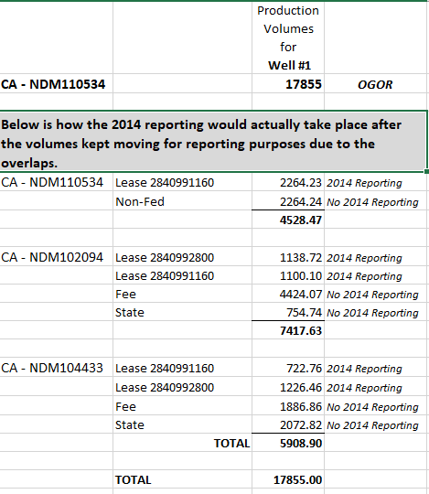
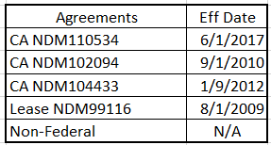
Reporting Example for NDM110534 (4 of 4)

Slide 25
How do I report on the
ONRR-2014???

Slide 26
2014 Reporting for NDM110534
In example CA NDM110534 the company holds 100% interest:
100% in Lease 2840991160
There is no lease basis well on this lease.
In overlapping agreement situations, you must report royalties based on your entitled share.
Let’s complete the ONRR-2014 for royalties on the above lease.

Slide 27
2014 Reporting Example for NDM110534 (1 of 3)
Total Sales Volume x allocation % x MNOP x working interest % = Sales Volume
Sales Volume x price x royalty rate – allowances = Royalty Value

Slide 28
2014 Reporting Example for NDM110534 (2 of 3)

Slide 29
2014 Reporting Example for NDM110534 (3 of 3)

Slide 30
Overlap Example 2

Slide 31
CA NDM110449
Map CA NDM110449
Review the reporting example
Create 2014 reporting

Slide 32
Example Overlap NDM110449 (1 of 2)

Slide 33
Example Overlap NDM110449 (2 of 2)

Slide 34
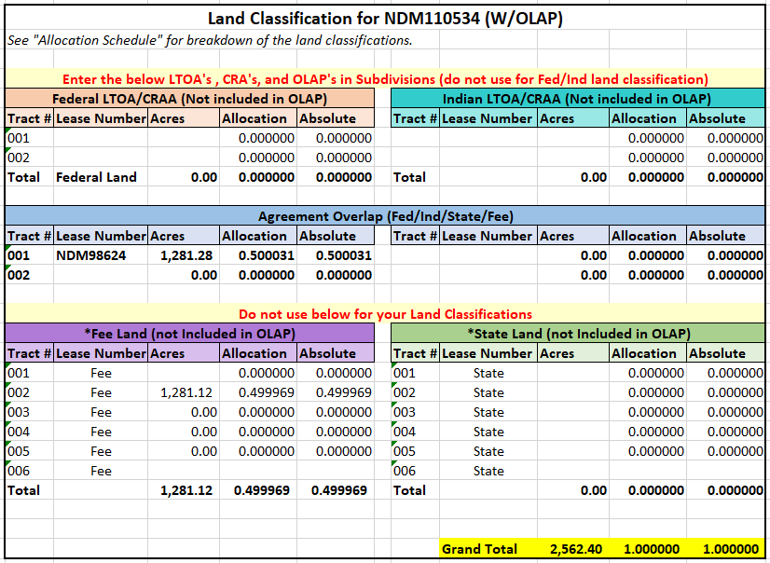
Allocation Breakdown for CA NDM110449

Slide 35
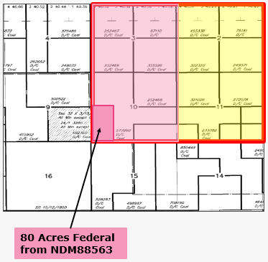
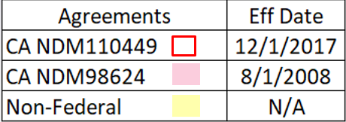
Map for NDM110449

Slide 36
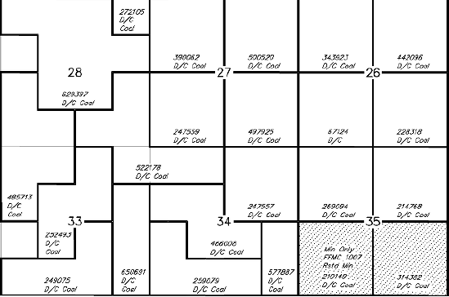
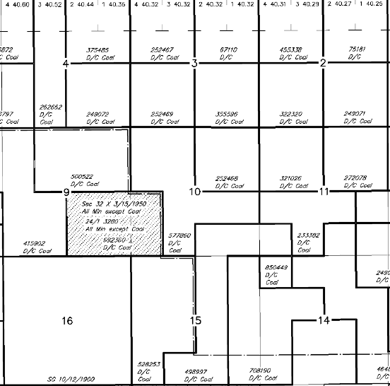
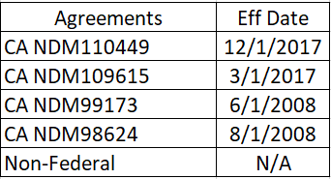
Old & New Map Comparison for NDM110449
Map prior ND IM
Map after ND IM

Slide 37
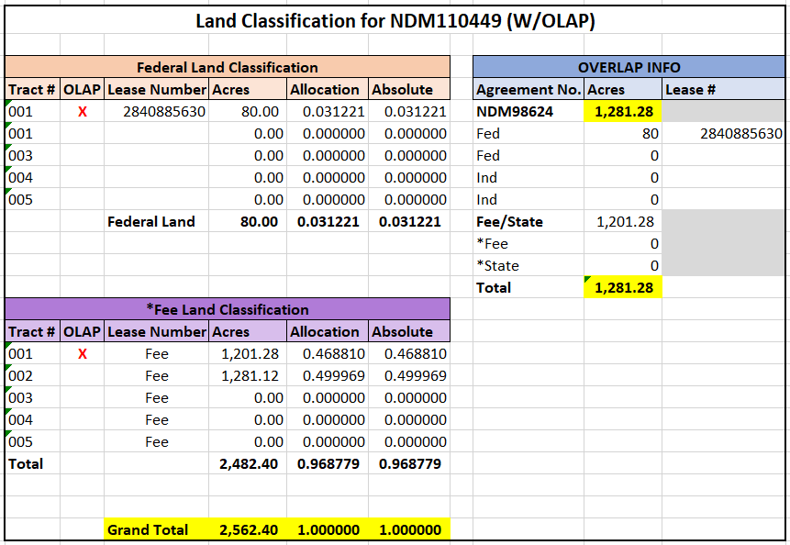
Land Class Breakdown for CA NDM110449

Slide 38
Reporting for Overlap Example 2

Slide 39
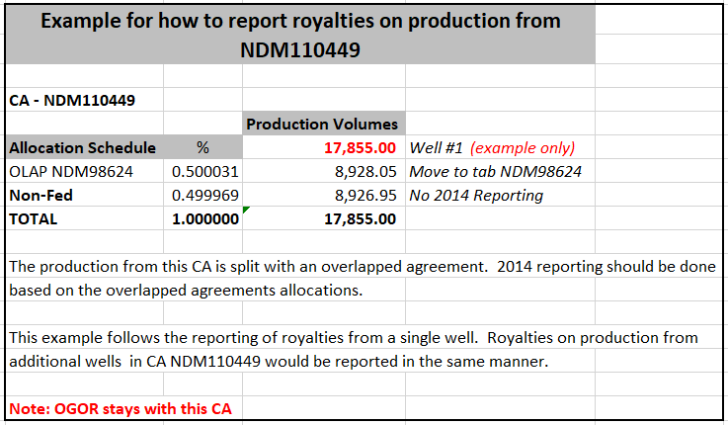
Reporting Example for NDM110449 (1 of 3)

Slide 40
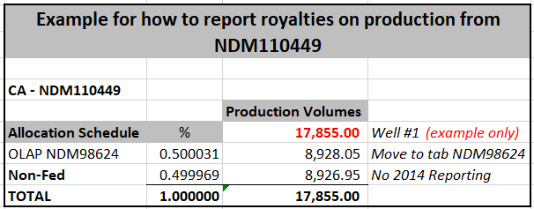
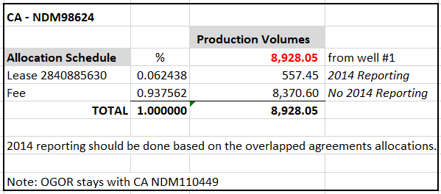
Reporting Example for NDM110449 (2 of 3)
CA NDM98624 within Overlap

Slide 41
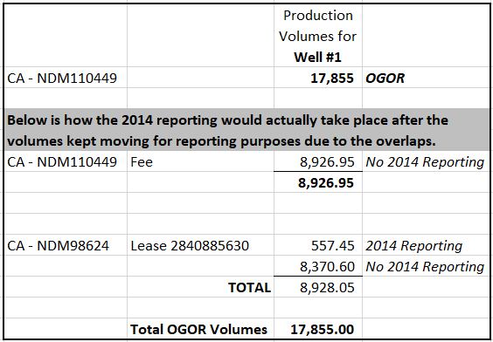
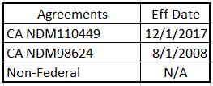
Reporting Example for NDM110449 (3 of 3)

Slide 42
2014 Reporting for CA NDM110449
100% of Production will be reported to CA NDM110449.
In example CA NDM110449 there are no leases to report directly to this CA.
Royalty reporting will be allocated to the base CA NDM98624 based on the that CA’s allocation schedule.

Slide 43
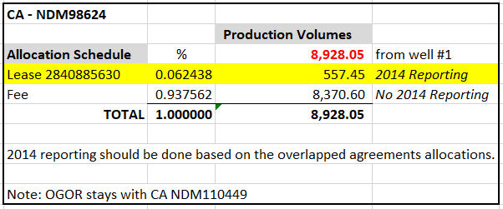
2014 Reporting Example for NDM110449 (1 of 3)
Total Sales Volume x allocation % x MNOP x working interest % = Sales Volume
Sales Volume x price x royalty rate – allowances = Royalty Value

Slide 44
2014 Reporting Example for NDM110449 (2 of 3)

Slide 45
Example 2014 Reporting for Overlapped CA NDM98624
2014 Reporting Example for NDM110449 (3 of 3)

Slide 46
Where do we get this information?
Operator
Land Department
Oil and Gas Commissions
MLRS - SRP
BLM
ONRR

Slide 47
Questions
Contact Information:
Matt Fields
matthew.fields@onrr.gov

