Slide 1
Reporter Online Training Housekeeping
All participants will be muted upon joining the training due to the large class size.
Please use the Audio heading at the top of the screen to test your speakers or headset. If you do not hear anything or do not have speakers, please click Audio – Audio Conference and follow the “Use Phone” instructions to listen via teleconference. Phone users, please mute yourselves upon entry.
Please use the WebEx Question and Answer feature to ask any questions. This feature is located at the top-right corner of the screen and says Q&A with a question mark. Please make sure to select “All Participants” when asking a question.
Please use the Chat feature for technical issues and select “All Panelists” in the dropdown. This will get you a faster response.
We will be using a closed captioning service during our Webex trainings. Please dropdown the multi-media feature or select the multi-media feature to view the closed captioning.

Slide 2
FACILITY MEASUREMENT POINTS
(FMP)

Slide 3
FMP Defined
The official Federal alpha/numeric code assigned to a facility (e.g., tank, gas plant or meter) that sells, stores, or transfers oil and gas production prior to or at the point of royalty settlement
Notes:
44
2
Note: BLM is expecting up to 75,000 royalty FMPs to be assigned once computer system is ready.

Slide 4
Facility/Measurement Point (FMP)
01 - Tank Battery
02 - Gas Plant
20, 21 - Liquid (LACT) royalty meter
22, 23, 24, 25 - Liquid allocation meter
30, 31 - Gas royalty meter
32 - Gas allocation meter
50 - Flaring and Venting meter
Notes:
Only for Offshore with the exception of the Gas Plants (02) for onshore

Slide 5
Allocation Meter
20170753850
Port Sulphur
(Facility Measurement Point)
WD 44
0550001370
WD 31
0550000160
WD 45G
23177193852
(allocation meter)
A measurement device used for determining the portion of volumes (Liquid or Gas) that is attributable to one or more platforms, leases, units, or wells, in relation to the total production from a royalty or allocation measurement point.
WD 45
0550001380

Slide 6
Description of FMP Number:
2017709260F
01, 20, 21, 30, 31, 50 – Sales Meter, 1st and 2nd digits
32, 22, 23, 24, 25 – Allocation Meter, 1st and 2nd digits
17 – State Code (17-LA, 42-TX, 60-Outer GOMR)
709 – Pseudo County Code
260 – System Number (identifies pipeline system)
F – Sub Location assigned by regional BSEE office
Notes:
FMP Number is ALWAYS 11 digits in length

Slide 7
County Codes

Slide 8
Commingling Indicators for FMP
1 – One lease, one operator, meter located on lease (non-commingled)
2 – One lease, one operator, meter located off lease (non-commingled)
3 – Commingled production with Other Sources (State lease production) - PASR required *
4 – Commingled production without Other Sources - No PASR required
*All FMPs that are assigned a Commingling Code of “3” require the submission of a Production Allocation Schedule Report (PASR) monthly.
Notes:
Used to allocate Federal/Sate production handout PASR for exercise
Account for production previously measured up stream for royalty determination

Slide 9
FMP Reference Data
Each Regional BSEE Office
Evaluates/Approves Commingling/Measurement Applications
Establish FMP numbers for all measurement points. Updates their system accordingly to reflect the approved data
Collect, review, and input source measurement documents (meter & tank run tickets, meter proving reports, & gas volume statements)
Notes:
Each BSEE Regional office approves commingling applications.
Once the applications are approved, the BSEE database is updated.

Slide 10
FMP Reference Data 1 of 2
FMP data is initialized into the ONRR Financial Accounting System from BSEE.
Captured to assure the facility is reported correctly and as approved; i.e., Operator, L/A, Commingling Code, Capacity, etc.
Link for LVS/GVS to compare the run tickets, tank tickets, and gas volume statements against the sales reported on the OGOR and/or PASR

Slide 11
FMP Reference Data 2 of 2
When FMPs pass Financial Accounting System edits, the accepted data is confirmed back to the designated operator of the FMP via the monthly FMP Confirmation Report through the Web Center Portal on the Internet.
Note: The designated meter operator of the FMP is not necessarily the designated lease operator.
Notes:
Was Data Center Portal…Minor differences

Slide 12
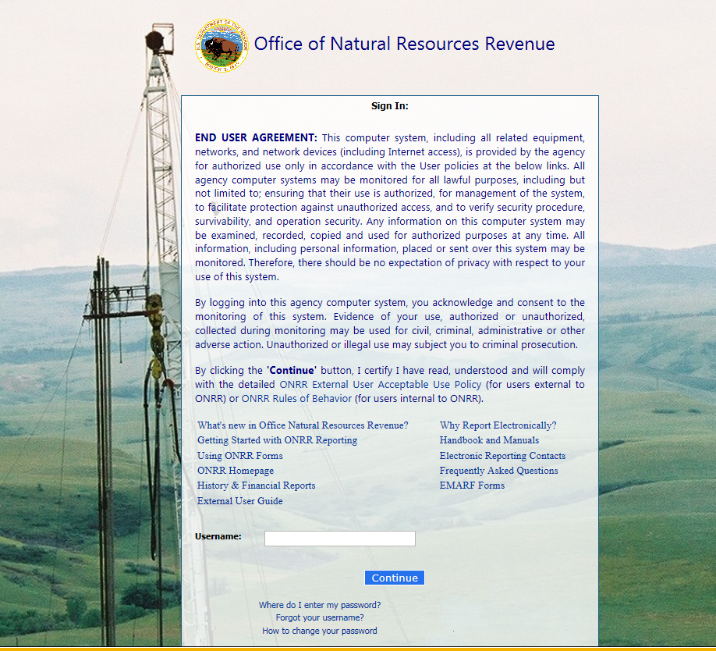
ONRR Login
Notes:
ONRR WebCenter Portal

Slide 13
FMP Confirmation Report 1 of 2

Slide 14
FMP Confirmation Report 2 of 2

Slide 15
BSEE Data Center http://www.data.bsee.gov/Main/
Notes:
To find an FMP number for a specific lease, unit, or operator, go to the BSEE web site at

Slide 16
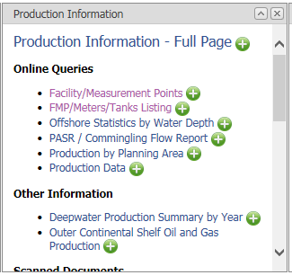
BSEE Data Center - Public use (continued)
Click either for FMP Information
Notes:
Facility /Measurement point..Put in Lease or Unit and you will get FMP(s)
FMP/Meters/Tank listing..Put in FMP and get all leases associated with it

Slide 17
FMP Online Query By Unit

Slide 18
FMP Online Query By FMP

Slide 19
Production Allocation Schedule Report
(PASR)

Slide 20
Overview
Both oil and gas production from offshore leases/agreements are transported to shore by either pipelines or barges
Pipelines are expensive and cost prohibitive to lay for each platform; therefore, production is “mixed” together which is transported to shore by common groups of pipelines or “systems.”
This mixing is called “commingling.”

Slide 21
Why a PASR?
The PASR is used to allocate only offshore products which are commingled through a single pipeline to the meter
Confirms the data reported on the OGOR
Provides key element required to work LVS and GVS exceptions

Slide 22
Allocations
To allocate commingled sales volume, production must be measured individually prior to commingling in order to establish an allocation factor
Volume is allocated to all leases/units contributing to the system. Operators receive their information from the system operators on a Monthly Allocation Statement
Lease operators report their allocated volume on the OGOR
Facility Measurement Point (FMP) operators report all allocated volumes, including Other Sources, on the PASR

Slide 23
Allocations
2217
Allocation Meter (22)
OCS-G 5202
SS189
5203
SS188
5204
SS210
7112502
SHELL
SS189A
TERREBONE
LIQUID HANDLING
TERMINAL
OCS-G 4001
ST173
4237
ST170
5604
ST144
EXXON
715250B
ST172
8910089460
ST172
OCS-G 1568
ST184
8910123350
ST185
715250E
UNION TEXAS
ST185A
OCS-G 5599
ST100
Sales Meter (20)
5602
ST111
715250K
TENNECO
ST100A&B
OCS-G 1597
WD137
20171012500
ELF
1598
WD138
7202500
ELF
WD138A
OCS-G 2332
EI392
3793
GI83
4464
ST200
2327
EI280
4885
ST147
-SCHEMATIC-
5548
SS165
4824
EI90
“Other Sources”
State

Slide 24
Other Sources
Oil and/or gas attributable to State lease production
(Unless the state well that participates in a Federal Unit).
Flash gas and Flash gas from pipeline (retrograde) condensate (Exception: Discovery system)
Production that has already been measured for royalty determination before entering the federal facility
Notes:
(see Dear Reporter Letter dated August 4, 2010)

Slide 25
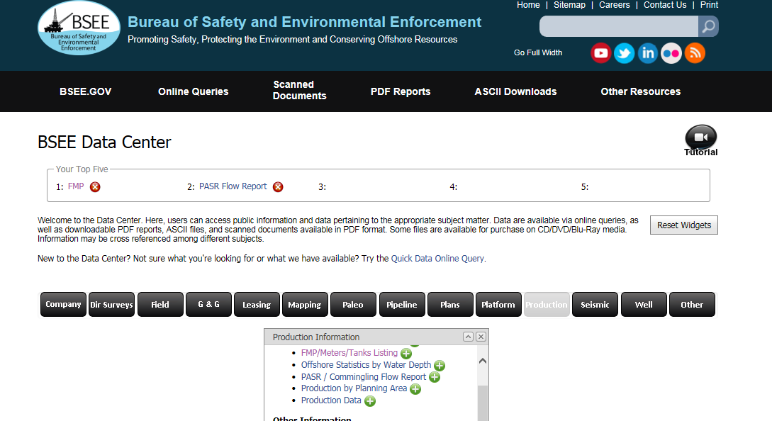
BSEE Data Center
Data center screen shots
BSEE Data Center provides meter and PASR Flow Report information.
BSEE Data Center provides meter and PASR Flow Report information.

Slide 26
BSEE Data Center

Slide 27
eCommerce PASR reporting
Click New PASR button to begin.

Slide 28
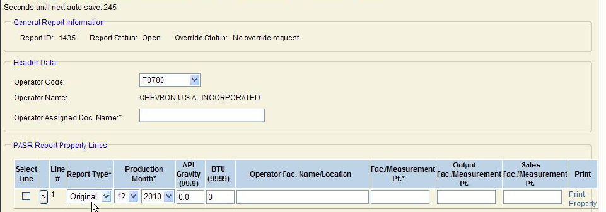
PASR Header and Property Line
Operator Code: Select Operator Code if authorized for multiple operator #’s
F1111
Big Oil Company
Document name assigned by operator
Req – But you decide
API Gravity for Oil FMPs (FMP Number
Starts with 2), Btu Content for Gas FMPs
(FMP Number starts with 3)
Ensure correct Report
Type is selected: Original,
Modify or Replace
Using the correct
Production Month is critical
Optional Field

Slide 29
PASR Property Line cont.
F1111
Big Oil
Enter the number of the FMP on which
the report is being submitted. The
Commingling indicator for this FMP
must be a 3 or 4. If this is not a sales
meter, fill in the Output and Sales
Fac./Measurement Pt. fields.
Enter the number of the Output/Sales
FMP. Leave blank if the number in the
previous block is a sales meter.

Slide 30
PASR Property Line cont..
Once all data is entered, click Product link.

Slide 31
PASR Product Information
Enter all Federal production
and Federal flash gas under
Sales/Transfers.
Optional: Select Oil,
Gas, Both or leave
blank.
Enter all state production, State
flash gas, and Federal/State
flash gas from retrograde under
Other Sources (except for the
Discovery System).
Enter the desired Action Code,
Add or Delete. Delete can only be
selected on Modify reports.
Enter either the Allocation FMP
or the Lease/Agreement number.
Both fields can not be filled in on
the same line. Both fields must
be blank if a volume is entered
under the Other Sources column.

Slide 32
Authorization Contact/Comments

Slide 33
Validate and Send PASR
Once error-free, click Send.
Click on Validate to check for errors or warnings.

Slide 34
Replace/Modify PASR
Replacement PASRs are submitted in the same manner as Original PASRs.
Modify PASR:
When submitting a Modify PASR (and only a Modify), a
Delete line can be used. If used, it:
must match the line being deleted from the original PASR
must be entered before the Add line(s)

Slide 35
PASR Confirmation
PASR Data is confirmed back to the production reporter through a monthly PASR Confirmation Report which is available through the Web Center Portal on the Internet.

Slide 36
WebCenter Portal

Slide 37
PASR Confirmation
zpcnfpsr

Slide 38
Summary
A PASR is required when the FMP is confirmed with a commingling code of 3 or requested by either BSEE or ONRR
PASRs are due on a monthly basis, even if there are no Sales/Transfer volumes
PASRs must be received by the 15th day of the 2nd month following the month of production.
PASR data reported to ONRR is compiled and sent to BSEE weekly

Slide 39
Summary
For questions regarding the PASR Confirmation Report or PASRs, contact your ONRR Offshore Analyst
https://onrr.gov/reportpay/PDFDocs/OffshoreProductionContacts.pdf
Notes:
Tell them joke about why the queen doesn’t wave with “this” hand

