Slide 1
Disclaimer
This presentation is guidance and not binding on ONRR. It does not provide legal advice and should not be construed as stating ONRR’s legal interpretation or position. Any reliance on this presentation does not limit ONRR in its compliance activities or in the appealable decisions and orders it may issue.

Slide 2
OGOR Comma Separated Values (CSV) Files

Slide 3
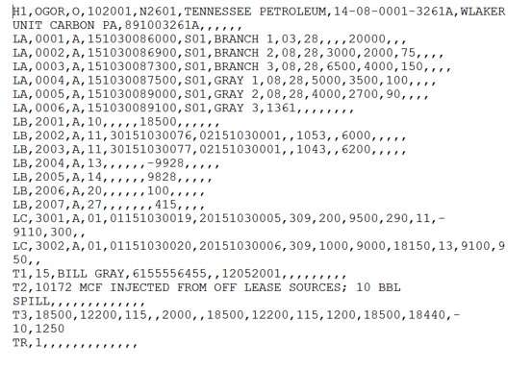
Comma Separated Value (CSV) Files
.CSV

Slide 4
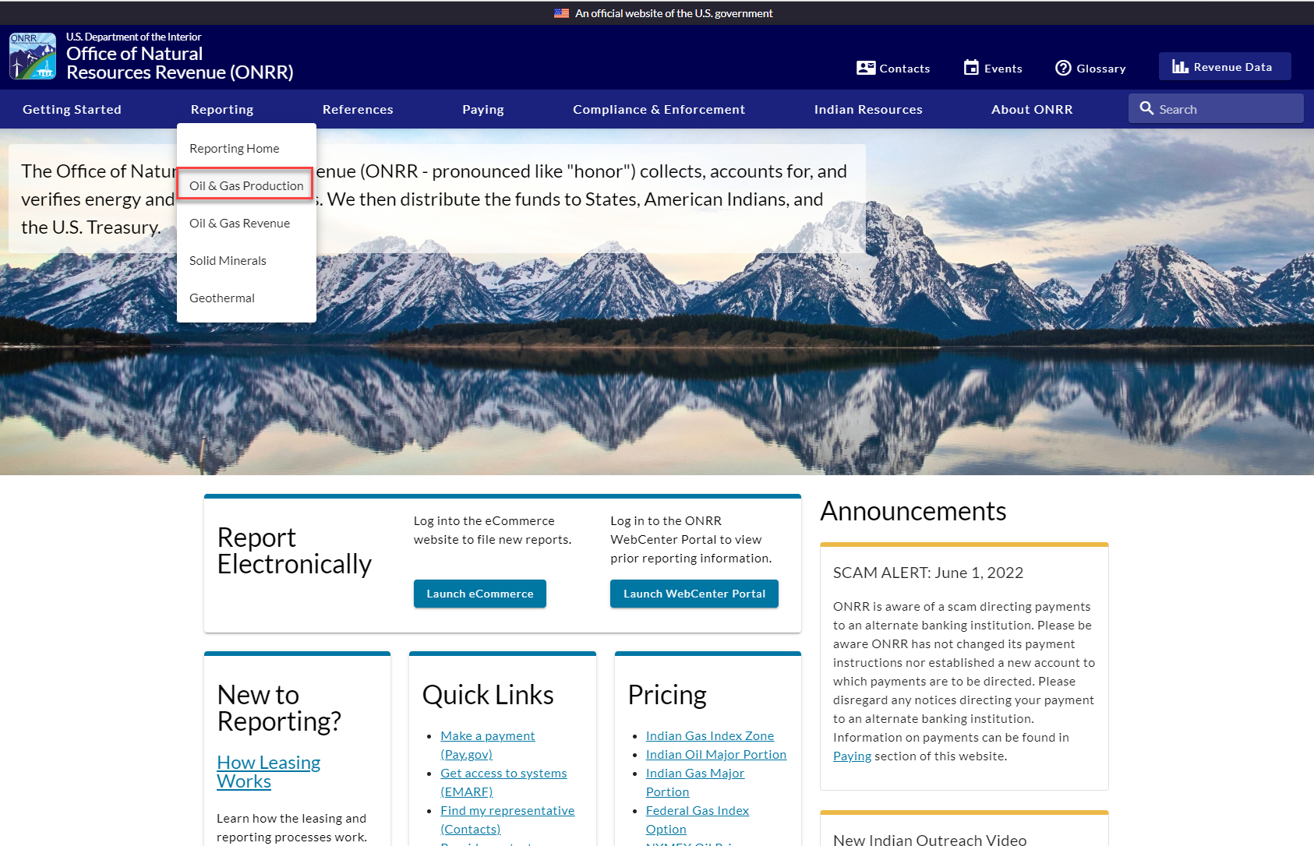
https://www.onrr.gov

Slide 5
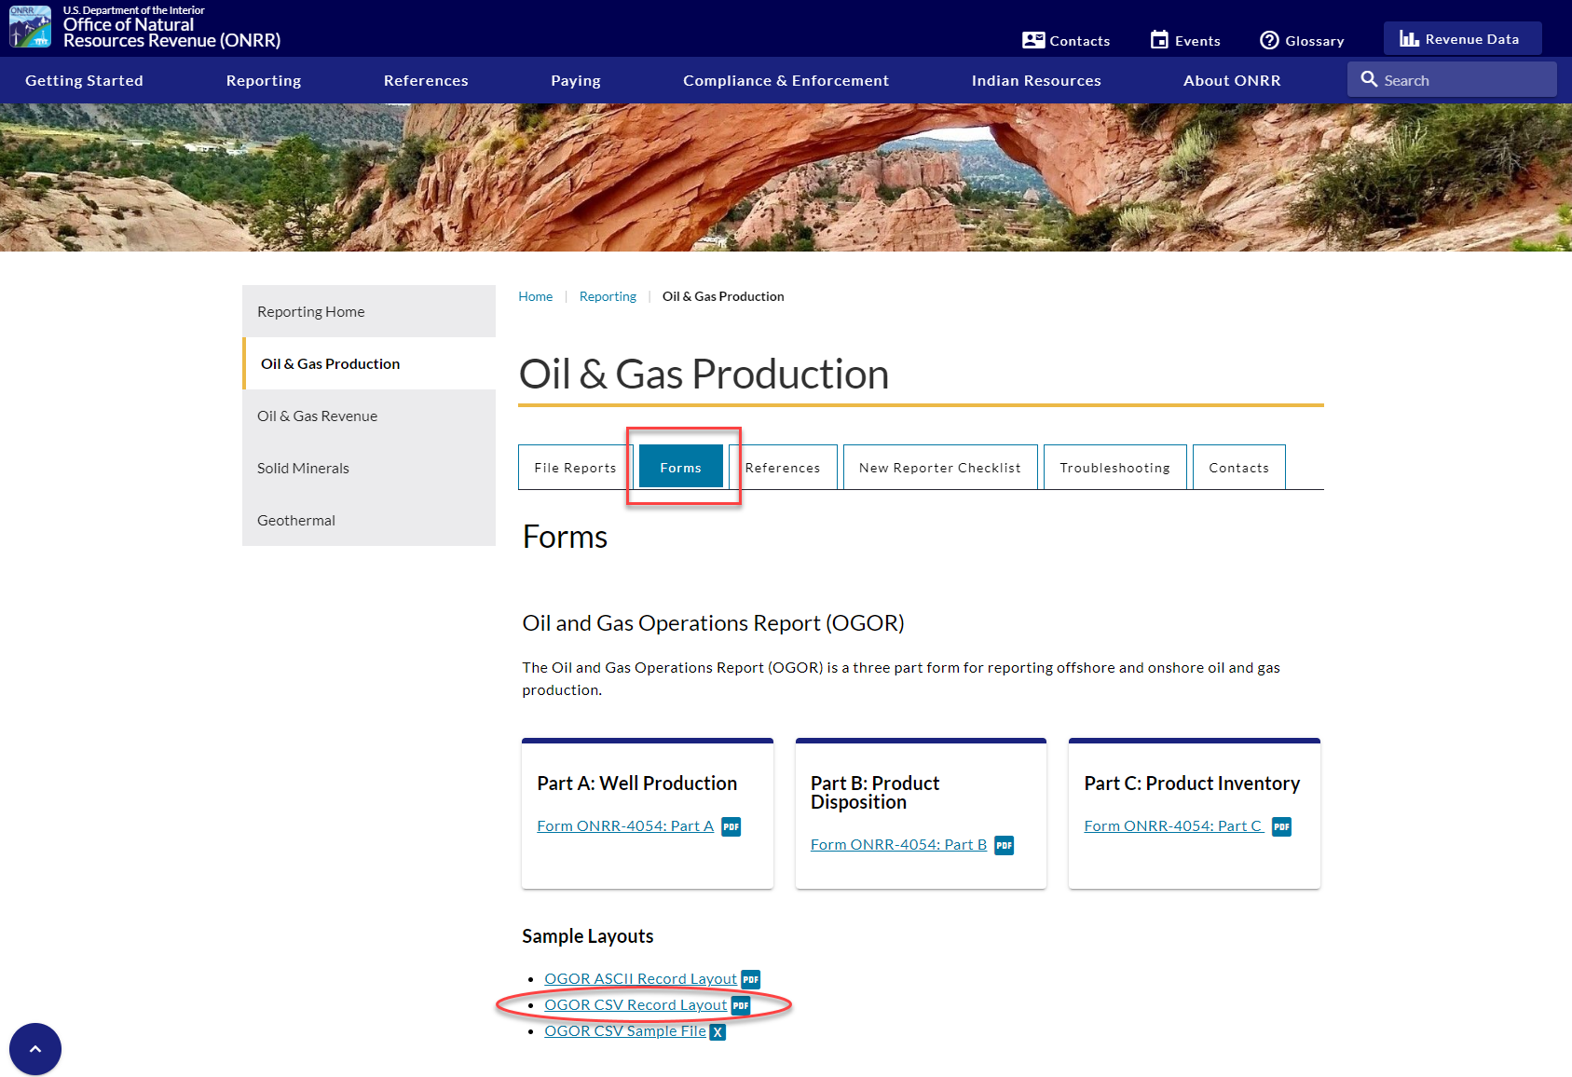
https://www.onrr.gov/reporting/production?tabs=forms
Instructions and Format for the .csv file:

Slide 6
OGOR CSV RECORD LAYOUT

Slide 7
Create .csv File
Comma Separated Value (CSV) files are first created in an Excel spreadsheet then saved as a CSV file type.
It is recommended that before entering data, you format the entire blank Excel worksheet as text to reduce formatting errors.
All data entry is done in the Excel spreadsheet.
Once a CSV file is saved, you will have two files - one with an .xlsx extension, the other with a .csv extension.
NEVER open or double-click the .csv file in Excel! Always make your corrections in your original Excel file, and then resave it to a CSV file. If you need to view the CSV file, view it in a text reader, such as WordPad. If you open the .csv file in Excel, you will lose ALL of the formatting from the Excel file.

Slide 8
Create .csv File (cont.) Format Requirements
All record fields must comply with the following requirements:
The file name must end with a .csv extension.
Commas must separate all fields. Fields that are blank still require a comma to delimit their position. A comma is not required after the last field of a record.
Multiple documents can be present in a single file. Headers and Trailers separate the documents.
Each document must begin with Record Type H1 and end with Record Type TR. The maximum number of combined LA, LB and LC lines is 50,000 per document. Do not use blank lines between multiple documents in a single file.
You must have at least one Record Type LA, LB or LC. The combination of Record Types you use depends on your particular reporting situation.
(See Minerals Production Reporter Handbook, Rel 2.0 for more information.)

Slide 9
Create .csv File (cont.) Format Characteristics
All record fields must comply with the following characteristics:
In the Maximum Width column, “X” equates to alpha-numeric characters and “9” equates to numeric digits. The number enclosed in parentheses ( ) is the number of characters/digits allowed for that specific field.
Use MMYYYY for Production dates and MMDDYYYY for Authorization dates. Be sure to add the leading zero where appropriate.
Do not use quotation marks (“) or apostrophes (‘).
For numeric fields, columns H-M (OGOR Parts A-C), DO NOT add leading zeros to these numeric fields. Leading zeros will be added during the conversion process where needed. When properly formatted, fields that have been defined as text will be automatically left justified.
Text fields must be correctly formatted to account for legitimate leading zeros (e.g., Product Code must be “02” not “2”; Well Status Code must be “08” not “8”).
API Gravity should be reported with no decimals (e.g., 35.6 should be reported as 356).
The OGOR-A line numbers start with 0001, OGOR-B line numbers need to start with 2001, and OGOR-C line numbers need to start with 3001.

Slide 10
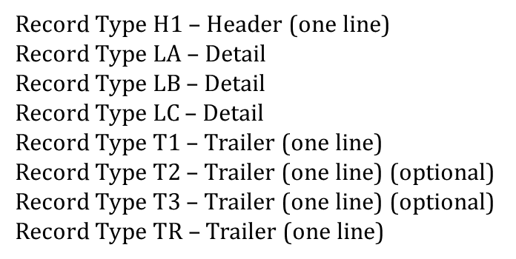
Record Types for a Single File – Reporting OGOR A, B, C
Regard each Record Type as an individual row of information. The Column field only indicates what column the data is entered in.

Slide 11
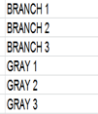
OGOR CSV SAMPLE FILE
Record Type
Original
OGOR A
OGOR B
Well Status XX, Reason Code XX, Well Action X
OGOR C
TT
T1 - Line Count, Contact Name, Phone #, Ext, Auth Date
Trailer Record (TR) and Document Count
Record Type Original, reporting OGOR A, B, and C. Using optional Trailers, T2 and T3.

Slide 12
OGOR CSV SAMPLE FILE WITH LARGE RED X OVER IT

Slide 13
OGOR CSV SAMPLE FILE (continued…)
T

Slide 14
OGOR CSV SAMPLE FILE (continued)
T

Slide 15
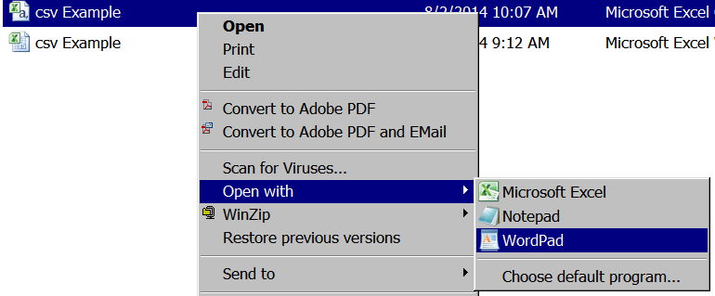
Create .csv File (continued…)
Save as .csv (Comma delimited)
If you need to edit after .csv is created, open with a text reader such as WordPad to preserve formatting, or open the Excel file and re-save as a .csv after editing is completed.

Slide 16
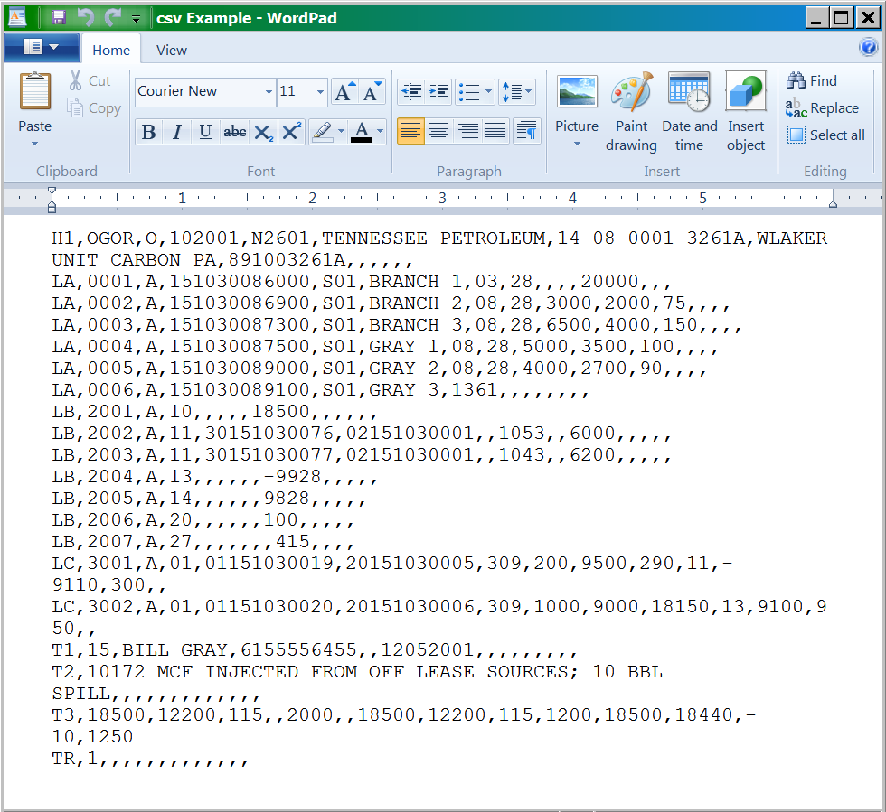
Create .csv File (continued)

Slide 17
Upload File
NOTE: Only .csv, .txt, and .zip formats are accepted file types to upload into eCommerce.

Slide 18
Upload File (continuation)
File successfully uploaded. Click on the Upload History tab to see the status of the file processing.
When you upload a correct .csv file, you’ll get this message.

Slide 19
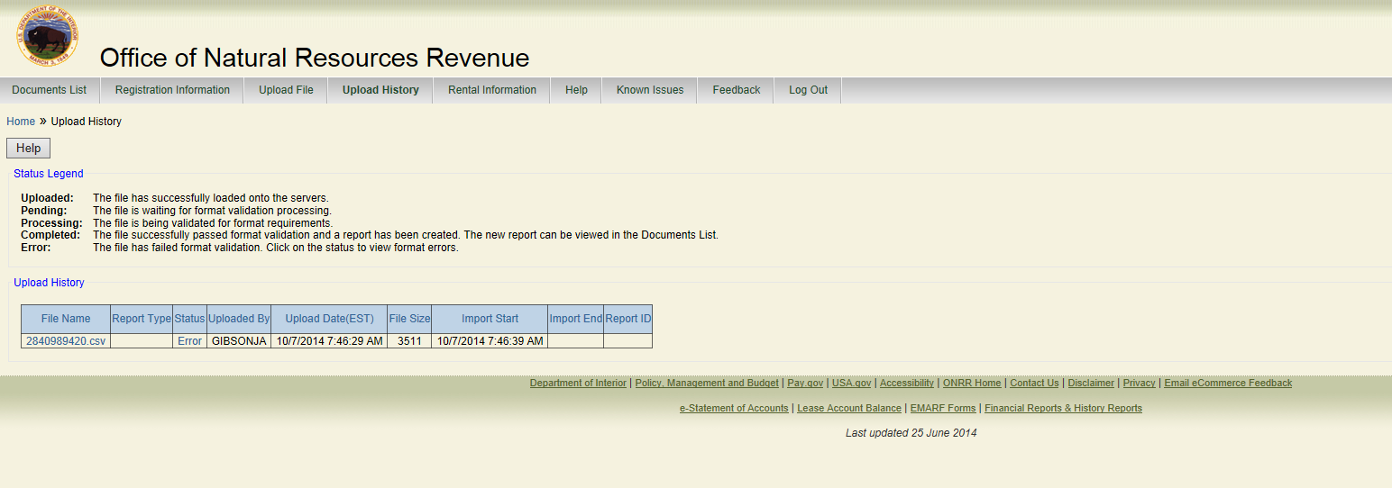
Uploading a File into eCommerce
Click on the Upload History tab to review the status of the uploaded file. File was successfully uploaded.

Slide 20
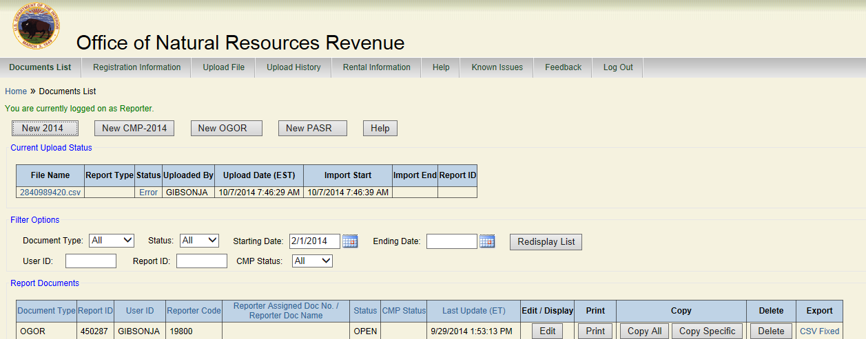
Upload Status in eCommerce
Another method to determine uploaded file status is to return to the Documents List. Newly uploaded files will display under Current Upload Status as well as under Report Documents.

Slide 21
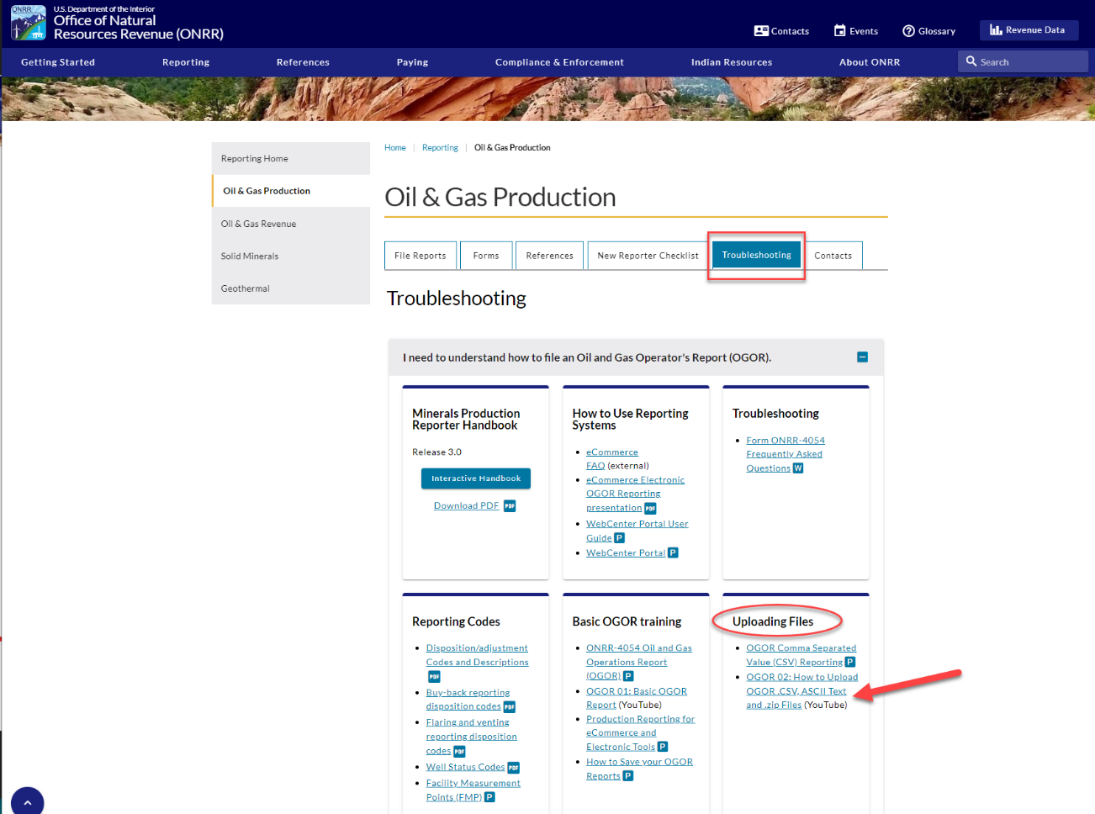
How to Upload .CSV, ASCII test, and ZIP Files
https://www.onrr.gov/reporting/production?tabs=troubleshooting&panel=i-need-to-understand-how-to-file-an-oil-gas-operators-report-ogor

Slide 22
Questions – Reporter.Training@ONRR.Gov

