Slide 1
Reporter Online Training Housekeeping
All participants will be muted upon joining the training due to the large class size.
Please use the chat feature to ask any questions.
If you require closed captioning, you can turn it on by clicking on the three dots (more), scroll down to CC. Once you click on CC the closed captioning will be on. Some of our presenters will be close captioning their presentations.

Slide 2
Disclaimer
These training materials are offered in a training scenario to serve as guidance to assist in reporting, paying, or determining value for royalties. Because reporting, payment, and valuation circumstances vary from lessee to lessee, be advised that these training materials may not precisely reflect your scenario. Accordingly, these general materials should not be construed as setting binding or enforceable policy.
Reliance on this guidance does not prohibit ONRR from future compliance activities or auditing of your reporting based on your use of the information contained within or from directing you to report and pay in a different manner based on an application of federal law to your unique factual circumstances. These training materials do not constitute an appealable decision or order under 30 C.F.R. 1290, Subpart B. If you have any questions, please use the contact information identified in this presentation or visit https://onrr.gov/about/contact.

Slide 3
Data Intake, Solutioning and Coordination
Missing Production Reports

Slide 4
Missing Exception Definition – 1 of 2
What is a Missing Exception:
  You have one well, multiple wells, or an entire contract which has not been reported to ONRR for a particular production month/year.
When do Missing Exceptions generate?
  Missing Exceptions generate the first Monday following the first full weekend of a month.
When to stop reporting? (ABD, P+A or Termination of contract)
  You must report the abandonment, then you may stop future reporting for that well.
  If a contract terminates, contact your Production Analyst for further guidance.

Slide 5
Missing Exception Definition – 2 of 2
Who is responsible for reporting Missing Exceptions once the property is sold?
  New operator or previous operator?
How are Missing Exceptions communicated to the operator?
  System generated in WebCenter Portal or by Analyst request
What reports are in Data Warehouse portal / WebCenter Portal for Operators?

Slide 6
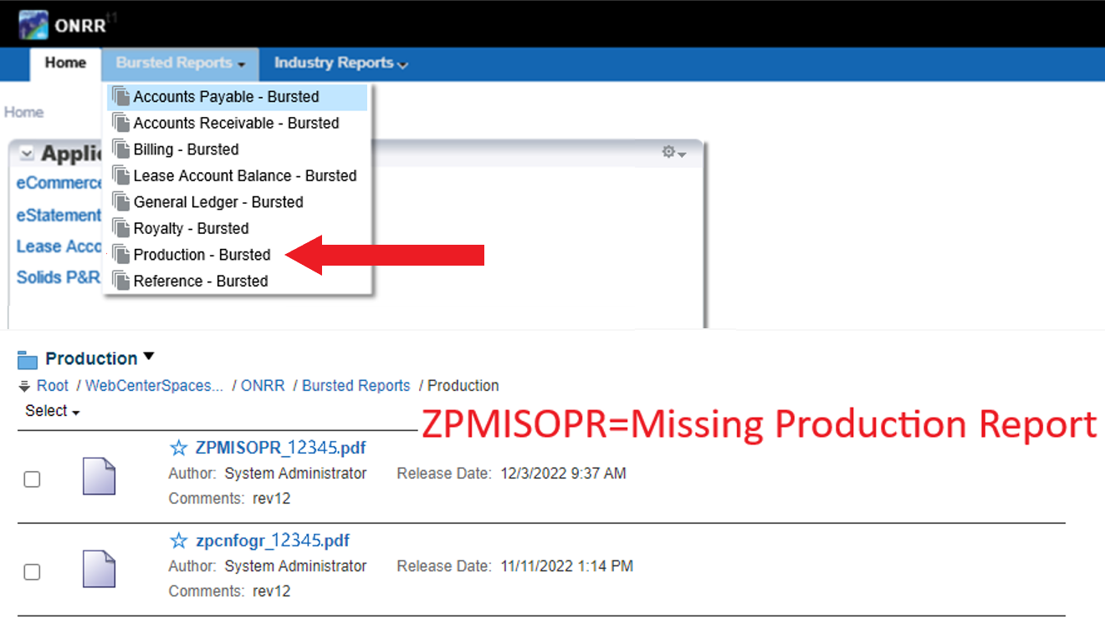
WebCenter Portal Bursted Report

Slide 7
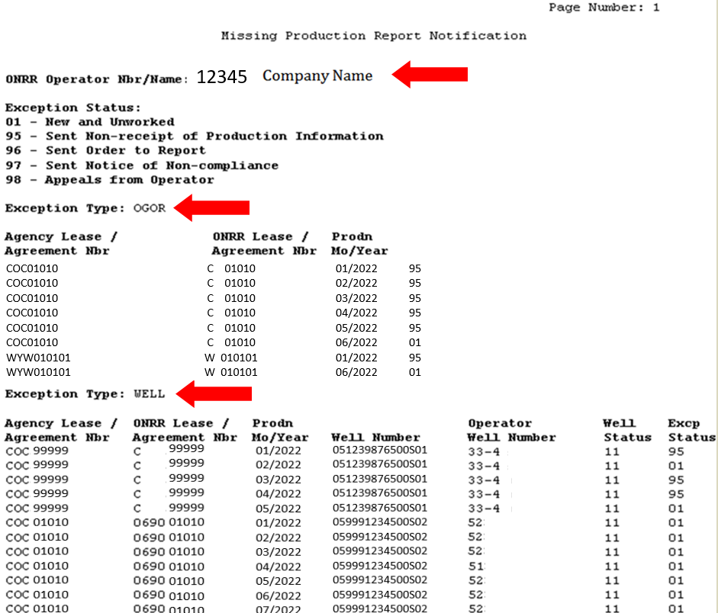
ZPMISOPR Missing Letter

Slide 8
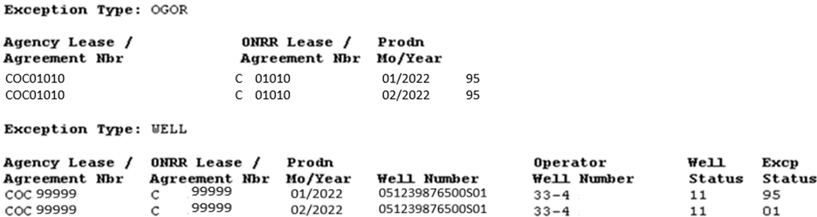
Understanding your Missing Report
Understanding the missing report you receive.
  “OGOR” and/or “WELL” line.

Slide 9
Why is it missing
Operator change
Well moved to a different lease/agreement
Well no longer in BLM or BSEE database
ONRR may have an OGOR or Well document on hold
Are the wells shut-in or temporarily abandoned?
If the exception is for a well, does the well belong on this lease/agreement?
Just because the Missing Exception Report shows a missing OGOR or WELL, it does not necessarily mean it is a valid missing exception.

Slide 10
Failure to Comply
What is failure to comply mean?
  Inaction on missing production reports or correct existing production reports.
  Ignored correspondence from your production analyst.
  No corrective actions taken either with BLM or ONRR to resolve your missing.
ONRR issue a Notice of Noncompliance

Slide 11
Notice of Noncompliance (NONC)
1 of 2
What is the Notice of Noncompliance (NONC)?
  Last action production analyst will take to get the reports submitted
  This is a legal process handled by our Enforcement Office
  This is out of the hands of production analysts
  Penalties will start on day 31 going back to day 1 if all violations identified in the NONC are not corrected within 30 days after the date on which an operator is served the NONC
  Enforcement analyst will attempt to reach out for assistance
  If all else fails case will be sent to treasury for additional action

Slide 12
Notice of Noncompliance (NONC)
2 of 2
Penalties
  ONRR is authorized by Section 109 of the Federal Oil and Gas Royalty Management Act of 1982 (FOGRMA) and 30 CFR §1241.52, to assess civil penalties of up to $1,522 per line per day ($15,232 per line per day after 40 days).

Slide 13
Avoid the Legal Process
  Offshore/Onshore Production Contact List
  https://www.onrr.gov/about/contact/production-contacts
  How to Use WebCenter Portal
  https://www.onrr.gov/document/Industry.WebCenter.Portal.User.Guide.pptx
  We are here to help

