Slide 1
Reporter Online Training Housekeeping
All participants will be muted upon joining the training due to the large class size.
Please use the chat feature to ask any questions.
If you require closed captioning, you can turn it on by clicking on the three dots (more), scroll down to CC. Once you click on CC the closed captioning will be on. Some of our presenters will be close captioning their presentations.

Slide 2
Disclaimer
These training materials are offered in a training scenario to serve as guidance to assist in reporting, paying, or determining value for royalties. Because reporting, payment, and valuation circumstances vary from lessee to lessee, be advised that these training materials may not precisely reflect your scenario. Accordingly, these general materials should not be construed as setting binding or enforceable policy.
Reliance on this guidance does not prohibit ONRR from future compliance activities or auditing of your reporting based on your use of the information contained within or from directing you to report and pay in a different manner based on an application of federal law to your unique factual circumstances. These training materials do not constitute an appealable decision or order under 30 C.F.R. 1290, Subpart B. If you have any questions, please use the contact information identified in this presentation or visit https://onrr.gov/about/contact.

Slide 3
Royalty Reporting Overview
Form-2014 Basic Reporting Principles
Presented by James Panetta

Slide 4
Course Objectives
System Access
Reporting/Paying Basics
Lease level reporting
Other Payments
Rents, Minimum Royalty
Estimated Royalties
ONRR Form-2014 Electronic Report
4

Slide 5
System Access
Obtaining Access, Establish Contact Information, EMARF Form, ONRR Systems

Slide 6
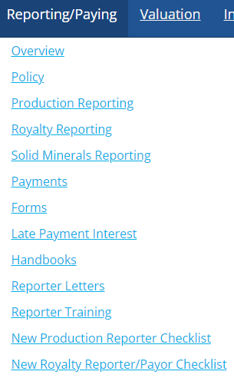
ONRR System Access
A payor code is needed to pay and report to ONRR
ONRR.gov, Reporting/Paying Tab, Reporter Checklists
REPORTERS MAY INCLUDE:
LESSEES
OPERATORS
PURCHASERS
INTEREST OWNERS

Slide 7
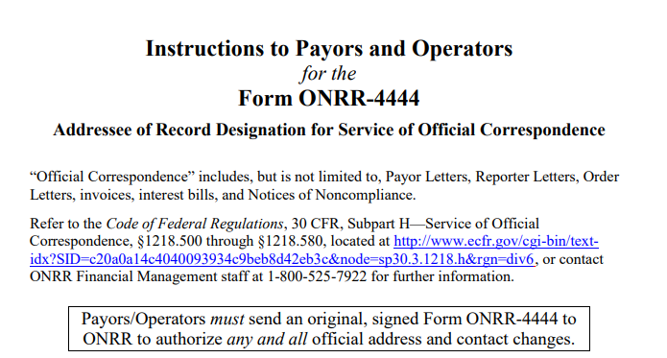
Establish Contact Information
Form ONRR-4444

Slide 8
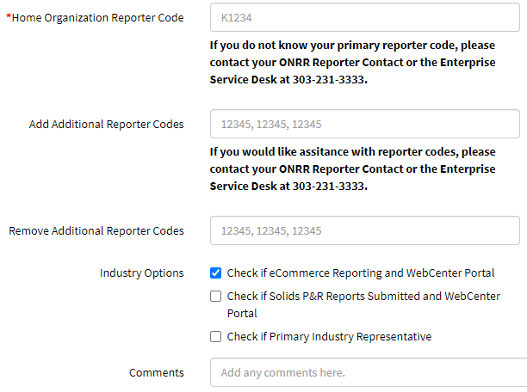
Electronic MRMSS Application Request Form (EMARF)

Slide 9
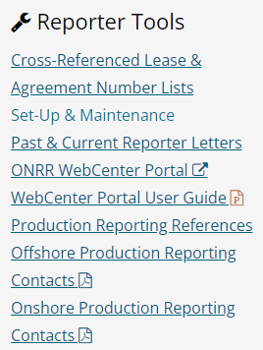
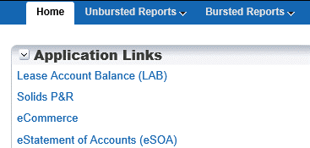
ONRR Systems
WebCenter Portal
eCommerce
Industry Reporters
Data capture
Payments
User guide
Link

Slide 10
Lease and Agreement Basics

Slide 11
Minerals Revenue Reporter Handbook

Slide 12
Leases Reported and Paid to ONRR
Federal Leases
Royalty (Producing)
Minimum Royalty
Rent
Indian Leases – Tribal & Allotted
Royalty (Producing)
Advance Rent (Producing)
Rent non-production leases committed to producing agreements
12

Slide 13
Lease Reporting
Lease-Basis Production
Royalty Value Calculation
Total Volume | x | Federal and/or Indian Mineral Ownership | = | Sales Volume
Sales Volume | X | Price | X | Royalty Rate | = | Royalty Value

Slide 14
Agreement Reporting
Sales Volume Calculation for Agreements:
Total Agreement Production Volume | x | Tract Allocation | x | Federal and/or Indian Mineral Ownership | x | Company Working Interest | = | Entitled Sales Volume

Slide 15
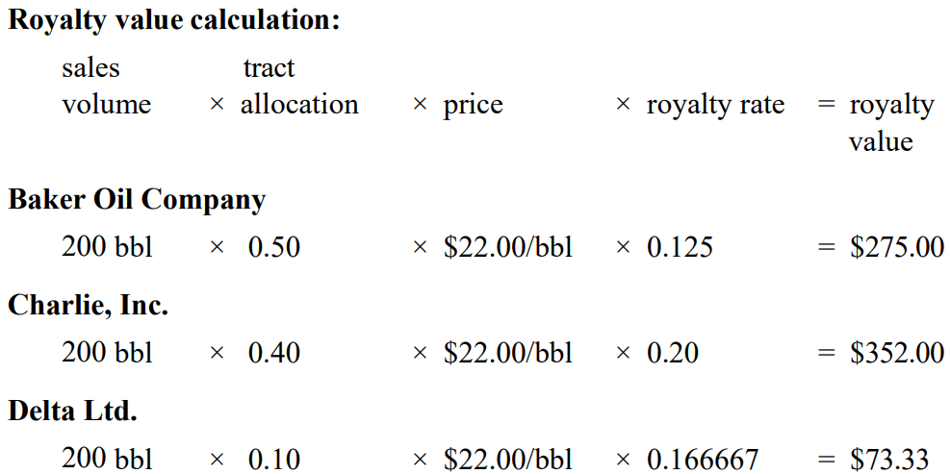
Agreement Reporting

Slide 16
Other Payments

Slide 17
Lease-Level Obligations
Payments and Reports to Lease Only, Including:
Minimum Royalty
Rent & Recoupable Rent
Estimates
Well Fees
Gas Storage Agreement Fees
Transaction Code | Transaction Type
02 | Minimum Royalty Payment
03 | Estimated Royalty Payment
04 | Rental Payment
05 | Advance Rental Credit

Slide 18
Minimum Royalty
Based on price per acre
Due on or before the last day of lease year
Royalties reported and paid throughout the lease year count towards fulfilling the obligation
Reported with TC 02 for Minimum Royalty

Slide 19
Rent & Recoupable Rent
Based on price per acre
Due on or before the lease anniversary date
May be recoupable against future production
Reported in eCommerce on Rent Tab
Reported on a Form-2014 only for Indian leases

Slide 20
Estimated Royalties

Slide 21
Estimates
Reported to the lease only
Once established, allows additional month to report and pay actuals on processed gas
Possibly avoid late payment interest charges
Benefits include:
Additional time to receive plant statements to accurately report and pay
Royalties now due on last day of second month following the month the product was sold or removed
Reported on Form-2014
Transaction Code 03 - Estimated Royalty Payment

Slide 22
Due Dates - Royalties
Due the last day of the month following the month product was sold or removed from the lease.
If last day of month falls on weekend or Federal holiday, royalties are due the next business day
i.e., November 2021 royalties are due 01/03/2022 (the last day of the month, 12/31/2021, falls on a Federal holiday)
Reports and payments must be made by 4:00 p.m. Mountain Time

Slide 23
Due Dates – Minimum Royalties/Rent
Both due by 4:00 p.m. Mountain Time
Minimum Royalties
Due on or before last day of the month/year of lease year
An estimate does not give additional time to pay Minimum Royalties
Rental Payments
Due on or before the lease anniversary date
Indian rental payments must include a Form-2014 report

Slide 24
ONRR Form-2014 Electronic Report

Slide 25
Reports and Payments
All payments and reports must contain:
5-digit Payor Code (ONRR assigned)
8-digit, or alpha numeric, payor assigned document number, or PAD number
The Payor Code and PAD number must match between the report and associated payment.
The payment total and Form-2014 report total must match.
Please remember to use a unique PAD number for all reports to eliminate the possibility of duplicate reporting.
For CMP’s, your auditor will assign you a unique PAD number to use on all reports associated with your audit.

Slide 26
Form-2014 Submission

Slide 27
Form-2014 eCommerce Interface

Slide 28
ONRR Form-2014 Parts
HEADER
DETAIL
TRAILER
Requires a valid payor code
Indicates if report is for Federal or Indian leases
Requires unique PAD number to match to the payment
Allows the reporter to assign their own naming convention to the report
Captures the lease number and agreement number, if applicable.
Allows for well number reporting
Drop-down menus to identify product type, sales type, sales date, transaction code, and adjustment reason codes
Required in .csv and .txt file uploads
Indicates the payment method used to pay royalties due from the report
Includes the authorized name and date

Slide 29
Form-2014 Detail

Slide 30
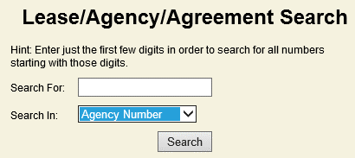
ONRR Lease/Agreement Numbering
Reporters must use valid ONRR converted Lease and Agreement Numbers http://www.onrr.gov/ReportPay/CrossRef.htm

Slide 31
API Well Number or US Well Number
Reported often to help track allocated production
Optional
Required on Southern Ute properties (Indian)
Required for offshore water relief properties

Slide 32
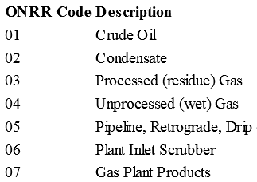
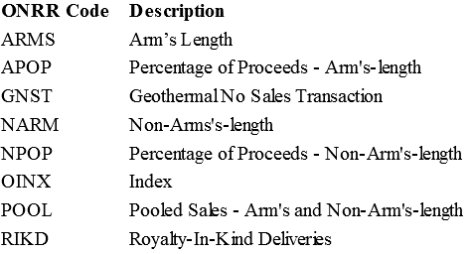
Product and Sales Type Codes
Product Code
Sales Type
Type of product sold
Contract type for the sale

Slide 33
Sales Date
The month and year the product was sold or removed from the lease
Royalties – the month the product was sold or removed from the lease
Minimum Royalty – the last month/year of the lease year that your minimum royalty obligation is due
Rent – Use the first month/year of the lease year that your rent is due

Slide 34
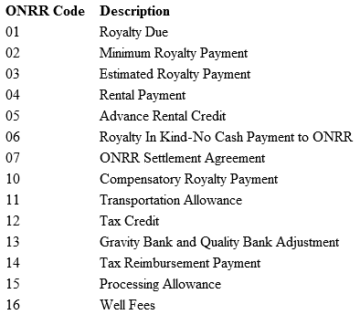
Transaction Code
Describes the nature of the transaction
Some transactions do not need all data fields completed

Slide 35
Data Elements by Transaction Code

Slide 36
ARC – Adjustment Reason Code
Indicates a reporting adjustment to an accepted line in ONRR’s database
Used by compliance teams at ONRR – CMP-2014

Slide 37
Sales Volume
Volume of product that is sold or removed from the lease
Measured in:
MCF for gas
Barrels (bbls) for oil
Gallons for NGLs
Long tons for Sulphur

Slide 38
Gas MMBtu
Required field only for gas related product codes
Gas MMBtu = Sales Volume x BTU Factor

Slide 39
Sales Value
MMBtu price for gas related product codes
Sales Value = gas MMBtu x MMBtu price
bbl, gal, Mcf, etc., for oil and other product codes
Sales Value = Sales Volume x unit price

Slide 40
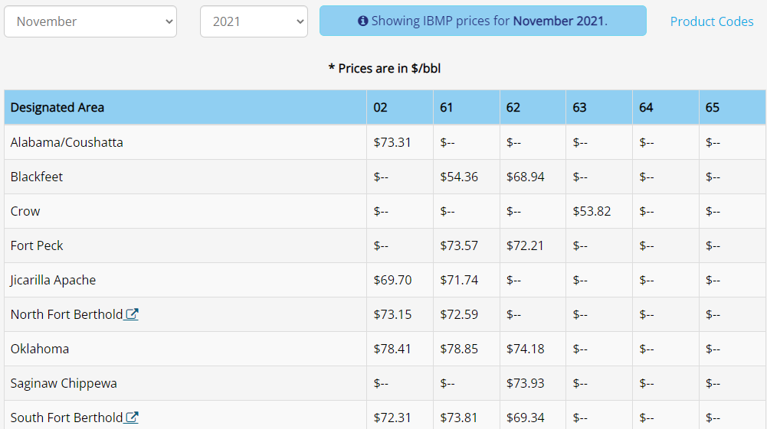
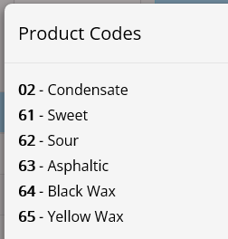
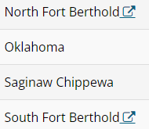
Indian Oil Index Based Major Portion Price (IBMP)
Published at https://www.onrr.gov/valuation/IndianOilIBMP.htm

Slide 41
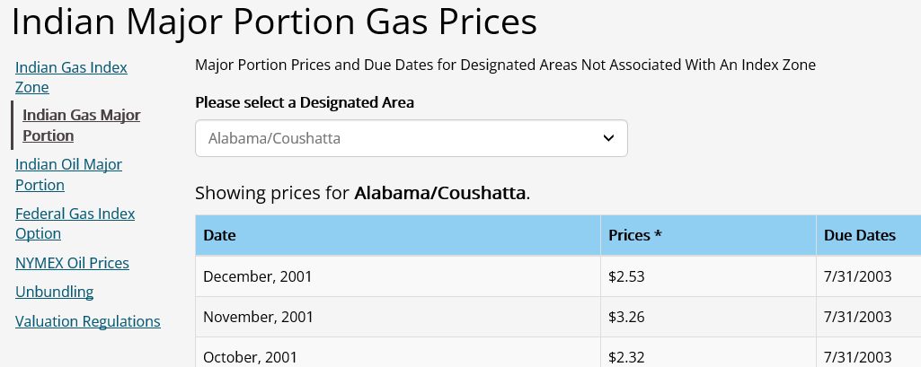
Indian Major Portion Gas Price
Published at https://www.onrr.gov/valuation/MonMajPP.htm

Slide 42
Royalty Value Before Allowances
Mandatory Field
Sales Value x Royalty Rate = RVBA
Used for non-royalty lines
Minimum royalty, rent
Enter the value of the payment

Slide 43
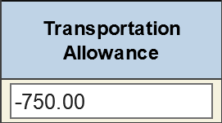
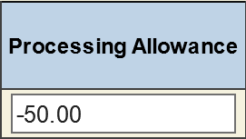
Allowances Transportation & Processing
Transportation
Processing
Deduction for actual costs of transportation
Cannot exceed 50% of the royalty value prior to allowances
Deduction from royalty due
Cannot exceed 66 2/3% of the royalty value prior to allowances, minus the transportation

Slide 44
Royalty Value After Allowances
Mandatory Field
RVPA - TA - PA = RVLA

Slide 45
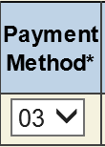
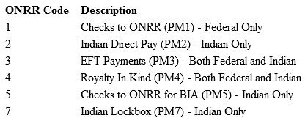
Payment Method Code
Mandatory Field
Identifies how the payment associated with the report will be made

Slide 46
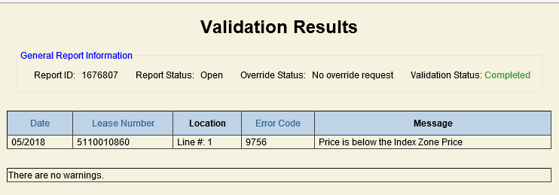
Report Validation
Final step before sending reports to ONRR
Automated check to ensure data accuracy

Slide 47
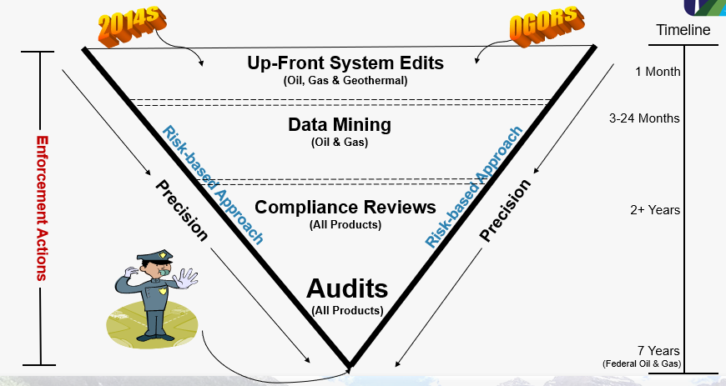
ONRR Data Accuracy Efforts

Slide 48
Form-2014 Override
Request from Reporter
Cannot correct the report to resolve the error
ONRR Royalty Team Processing
Peer review
Supervisor approval
Other Approvals
ONRR Audit and Compliance Management
State and Tribal Auditors
ONRR Financial Management

Slide 49
Contacts and Resources
Minerals Revenue Reporter Handbook ONRR Release 4.0 ♦ 06/04/2020
https://www.onrr.gov/reportpay/handbooks/pdfdocs/RRM-Printable.Minerals.Revenue.Handbook.pdf
ONRR Form-2014 Training Videos
https://onrr.gov/reportpay/training/2014-Training-Videos.htm
Indian Payor Handbook https://onrr.gov/reportpay/Handbooks/indian-payor-handbook.htm

Slide 50
Contact Information
https://onrr.gov/about/contact.htm
Royalty Reporting Contacts
https://www.onrr.gov/ReportPay/PDFDocs/royassign.pdf
Lease/Agreement Maintenance Contacts
https://onrr.gov/reportpay/PDFDocs/RS_LeAgAssignments.pdf
Production Reporting Contacts
https://onrr.gov/reportpay/PDFDocs/OnshoreProductionContacts.pdf

Slide 51
Question and Answer Time!

