Slide 1
Reporter Online Training Housekeeping
All participants will be muted upon joining the training due to the large class size.
Please use the chat feature to ask any questions.
If you require closed captioning, you can turn it on by clicking on the three dots (more), scroll down to CC. Once you click on CC the closed captioning will be on. Some of our presenters will be close captioning their presentations.

Slide 2
Disclaimer
These training materials are offered in a training scenario to serve as guidance to assist in reporting, paying, or determining value for royalties. Because reporting, payment, and valuation circumstances vary from lessee to lessee, be advised that these training materials may not precisely reflect your scenario. Accordingly, these general materials should not be construed as setting binding or enforceable policy.
Reliance on this guidance does not prohibit ONRR from future compliance activities or auditing of your reporting based on your use of the information contained within or from directing you to report and pay in a different manner based on an application of federal law to your unique factual circumstances. These training materials do not constitute an appealable decision or order under 30 C.F.R. 1290, Subpart B. If you have any questions, please use the contact information identified in this presentation or visit https://onrr.gov/about/contact.

Slide 3
FINANCIAL SERVICES
Federal Billing
Jessica Sheets

Slide 4
Learning Objectives Federal Leases
Identify various ONRR invoices
Understand how obligations are generated
Learn how reporting affects invoices

Slide 5
ONRR Invoices
Common invoices FIN invoices - issued for underpaid or nonpaid lease term obligations INT invoices - issued for late paid royalties and invoices, and insufficient estimates Non-routine invoices OTH Invoices - issued for civil penalties, rig fees, liquidated damages

Slide 6
FIN Invoices
Lease Term Obligations
Federal and Indian

Slide 7
FIN Invoices Lease Term Obligation Types
Minimum Royalty
Rent
Non-terminable Including recoupable
Rent
Nominally-Deficient on terminable
Right-of-Way
Right-of-Use
and Easement
Well & Storage Fees
Deferred Bonuses

Slide 8
FIN Invoices Minimum Royalty
Due at end of lease year if not met through 2014 royalties
Pay ahead of time on 2014
Pay through Pay.gov, ACH, or Fedwire
Common error - Incorrect sales date on 2014
FIN invoice issued once MR due date is 90 to 105 days late
Interest is already accruing at this point

Slide 9
FIN Invoices Rent
Due on anniversary date
Payment Options
eCommerce Online Rental Payment System - Required for TERMINABLE leases; NOT allowed for Indian leases
Pay through Pay.gov, ACH, or Fedwire - Report on Form ONRR-2014; cannot report on TERMINABLE lease
Contact Bureau of Land Management if lease terminated for no rent payment
FIN invoice issued once Rent due date is 30 to 45 days late
Interest is already accruing at this point

Slide 10
FIN Invoices Common Issues
Lease status - expired or terminated, producing vs. non-producing
Ownership - record title assignment not approved
Incorrect amount due
Wrong sales date used on 2014
Suspension lifts
Timing

Slide 11
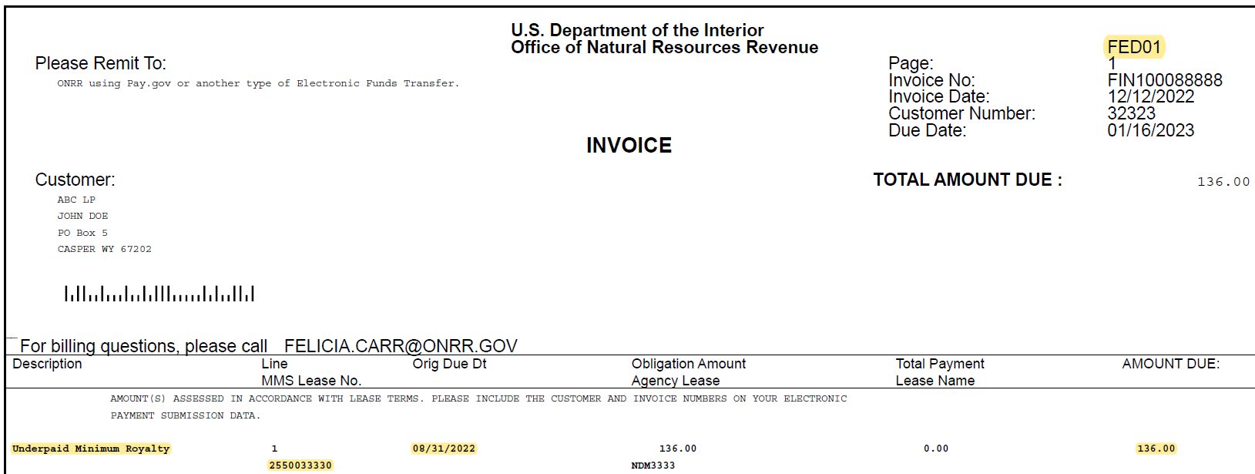
FIN Invoice Example Minimum Royalty

Slide 12
INT Invoices
Late Payment of Receivable
Federal and Indian

Slide 13
Interest Regulation
30 CFR 1218.54

Slide 14
Interest Invoice
Late payment of royalties including CMP documents
Late payment of INT, FIN, and OTH Invoices
Interest on insufficient estimates

Slide 15
Interest Invoice Interest rates and methods of calculation
Federal and Indian, Oil & Gas leases
IRS underpayment rate for corporate taxpayers
Interest compounds daily
Formula
$$I=A\left[{\left(1+\frac{R}{N}\right)}^{n}−1\right]$$
Federal and Indian, Solid Mineral & Geothermal leases
United States Treasury current value of funds rate
Simple interest

Slide 16
Interest Invoice Interest Calculation
From obligation due date to payment receipt date Multiple payments allocated from oldest receipt date to newest.
Running Balance Method
Multiple sales dates on same 2014 - interest calculated from royalty due date to royalty due date of subsequent sales date(s) until payment receipt date reached

Slide 17
Running Balance Explanation
2014 reporting paid 01/29/2023, no estimate
$1,000 for Sales Date 08/2022
$(600) for Sales Date 09/2022
$800 for Sales Date 10/2022
Interest calculation (interest compounded daily):
$5.11 interest on $1,000.00, 10/01/2022 - 10/31/2022 @ 6%
$2.00 interest on $405.11 ($1,000.00 + $5.11 interest - $600.00), 11/01/2022 - 11/30/2022 @ 6%
$6.17 interest on $1,207.11 ($405.11 + $2.00 interest + $800.00), 12/01/2022 - 12/31/2022 @ 6%
$6.77 interest on $1,213.28 ($1,207.11 + $6.17 interest), 01/01/2023 - 01/29/2023 @ 7%

Slide 18
Interest Invoice Obligation Due Dates
Royalties
End of month following the sales date
Invoices
INT and OTH
FIN
Sales date 01/31/2023 is due 02/28/2023
Invoice due date
not the invoice due date
Lease term obligation due date,
If due date falls on a weekend or federal holiday,
the due date is extended to the next business day.

Slide 19
Interest Invoice Enclosures
Interest Schedule
Estimate amount
Royalties
Variance
Late Payment Allocation
Payments applied
Due date for each sales date
Shows interest type - late royalty payment, insufficient estimate
Lease number
Interest calculation details
Estimate Report

Slide 20
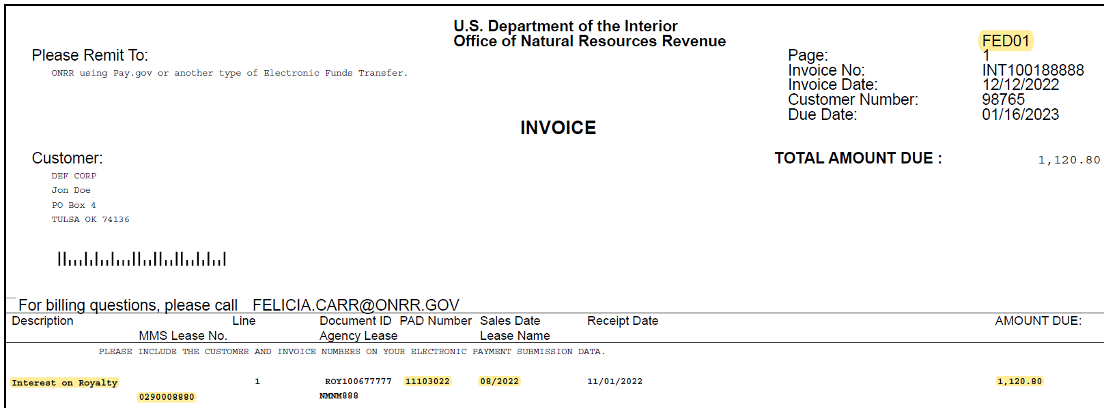
Late Payment of Royalties Bill Summary Page
Royalties paid late on Lease 0290008880 for Sales Date 08/31/2022

Slide 21
Late Payment of Royalties Interest Schedule
Royalties on Lease 0290008880 for $219,399.96
Sales date 08/31/2022 is due 09/30/2022
Payment date 10/31/2022
Interest due from 10/01/2022 - 10/31/2022 in the amount of $1,120.80

Slide 22
Late Payment of Royalties Late Payment Allocation
Payment(s) applied to receivable:
Portion of receivable and payment applied:

Slide 23
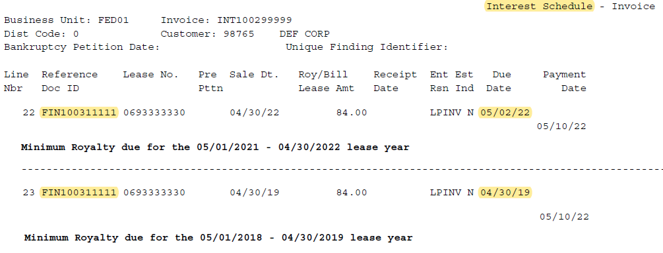
Late Payment of FIN Invoice Interest Schedule
FIN100311111 issued for Minimum Royalty due
04/30/2022 and 04/30/2019 at $84.00/lease year

Slide 24
INT Invoice Example Insufficient Estimate
Sales date 08/2022 is due 09/30/2022
Extended due date with estimate 10/31/2022
Extended estimate reporting period 10/01/2022 - 10/31/2022
If reporting is received after 10/31/2022, estimate due date will NOT be extended

Slide 25
Insufficient Estimate Interest Schedule
Due date for $100,774.76 of the $920,774.76 royalties should not have been extended the additional month
Interest charged for the additional month on $100,774.76

Slide 26
Insufficient Estimate Estimate Exception Bill Details
Interest due from 10/01/2022 to 10/31/2022 on estimate variance
(the amount not covered by an estimate)

Slide 27
Supplemental Information
Adjustment Reason Code 35 and Cross Lease Netting

Slide 28
Adjustment Reason Code (ARC) 35 Agreement-Related Adjustments
Unit Agreement (UA), Communitization Agreement (CA), Participating Area (PA)
For a new or revised agreement, royalty due date is
last day of month after date of approval letter
2014 Reporting:
Sales dates between agreement effective date and approval date, use ARC 35
Sales dates prior to agreement effective date and/or after approval date, use ARC 10

Slide 29
Agreement Example
Agreement effective 09/01/2021 and BLM approved 03/29/2022
No interest assessed IF:
Sales Dates between 09/30/2021 and 03/31/2022 are adjusted, and
Payment received by 04/30/2022
Report Sales Dates between 09/30/2021 (effective date) and
03/31/2022 (BLM approval date) using ARC 35
Report Sales Dates prior to 09/30/2021 and/or
Sales Dates after 03/31/2022 using ARC 10
To receive interest due date extension for ARC 35, report adjustments on its own 2014

Slide 30
Cross Lease Netting (CLN)
30 CFR 1218.42 (b)

Slide 31
Cross Lease Netting Criteria
Sales volumes must directly offset
Same payor
Same lessor
Same ultimate recipients (i.e., same distribution to GOMESA, 8g Fund, state, etc.)
Royalty Value Less Allowances (RVLA) do not have to directly offset, interest assessed on underpaid difference
Report CLN on separate 2014, not with monthly reporting

Slide 32
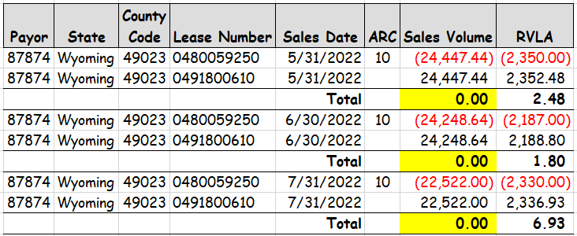
Cross Lease Netting Example

Slide 33
OTH Invoices
Federal ONLY

Slide 34
OTH Invoices Types
Inspection Fees
Rig - Monthly Basis
Non-Rig - Quarterly Basis
Fixed Rig - Quarterly Basis
Requested from sister agencies
Fishermen Contingency Fund
Liquidated Damages
Result of payment identified as Federal instead of Indian, or vice versa.
Civil Penalties
Issued for non-compliance from ONRR’s Office of Enforcement

Slide 35
Liquidated Damages OTH Invoice
Always Federal for Indian payment infraction
Read enclosed letter for detailed information

Slide 36
Liquidated Damages Enclosed Letter

Slide 37
Supplemental Actions Questions/Inquiries
Accountant
Contacts
ONRR Accountant
Many questions can be handled by the accountant shown on the invoice
Appeals
Exercise appeal rights received with invoice if issue isn’t resolved
For more information concerning appeals, visit ONRR.gov.

Slide 38
Review - Federal Portion
Financial Lease Term Obligations Invoice (FIN)
Unpaid or underpaid lease term obligations such as rent, minimum royalty, well fees, storage fees, advance royalty, right of way fees, etc.
Interest Invoice (INT)
Issued for late payment of royalties, invoices, and insufficient estimate balances
Other Invoice (OTH)
Issued for all other fees and penalties such as liquidated damages, civil penalties, inspection fees, fisherman’s contingency fund
Please contact the name shown on the invoice with questions

Slide 39
Resources
ONRR website
Home | Office of Natural Resources Revenue (onrr.gov)
Payments
Payment Options | Office of Natural Resources Revenue (onrr.gov)
Interest Rates
Late Payment Interest | Office of Natural Resources Revenue (onrr.gov)
Federal and Indian Accounts Receivable contacts
Contacts | Office of Natural Resources Revenue (onrr.gov)
eCommerce and WebCenter Portal
Sign On (onrr.gov)
Contact Name and/or Address Update
Form ONRR-4444, Addressee of Record Designation for Service of Official Correspondence
Instructions for Form ONRR-4444
Microsoft Word - Form ONRR-4444 Instructions

Slide 40
QUESTIONS

Slide 41
INDIAN LEASE BILLING
Indian Billing
John Ellis

Slide 42
Learning Objectives
How to report and pay Indian Lease Rent, Minimum Royalty, Well & Storage Fees
Rules for Indian Recoupment 30 CFR-1218.53, Paragraph (A) and (B)
Indian Overrecoupment (IOR) Invoice
Tribal Recoupments
Major Portion Pricing

Slide 43
INDIAN RENT 1 of 2
Due on anniversary date
Payment Options
Indian leases are not available in the eCommerce Online Rental Payment System (ORPS)
Report on Form ONRR-2014, and pay electronically (Pay.gov, ACH, Fedwire) except;
Tribal leases that require lockbox payments must be paid according to those lockbox instructions

Slide 44
INDIAN RENT 2 of 2
Non recoupable rent
Recoupable rent
Recoupable against TC01 royalties in that lease year
Recoup using TC25

Slide 45
REPORT INDIAN LEASES ON 2014
RENT
Transaction Code (TC) 04
ADVANCED RENT
TC 05
MINIMUM ROYALTY
TC 02
Well Fees
TC 16
Storage Fees
TC 17
Pay with PAY.GOV, ACH, or FED WIRE
Common Error:
Incorrect sales date used on 2014
If you receive a FIN Invoice, the contractual lease term obligation is LATE and interest is accruing
45

Slide 46
INDIAN RECOUPMENT

Slide 47
Indian Recoupment Regulation
30 CFR 1218.53, Paragraphs (a) and (b)

Slide 48
Indian Recoupment Rules
30 CFR- 1218.53
Recoupment Against Tribal Lease
Limited to 100% against current revenues
Limited to specific lease unless you receive written Tribal permission.
Allotted Lease
Limited to 50% of current revenues
Lease specific
Split Lease
Limited to 50% of current revenues

Slide 49
Indian Over-recoupment (IOR) Invoice

Slide 50
IOR Invoice Lines - Basic
Correct:
Incorrect (Allotted):

Slide 51
Indian Over Recoupment Explanation 1 of 2
CURRENT REVENUE
Royalty owed for the current report month, as well
All other lease revenue reported in the same month, such as annual rent and positive adjustments to previously reported sales months, less
Recoupment (transaction code 25) of the current lease year’s advance rental payment.
IOR invoices calculate based on all reporting, per lease, for a Report Month (11th of a month to the 10th of the following month). For example, 03/11/2024 – 04/10/2024.

Slide 52
Indian Over Recoupment Explanation 2 of 2
Negative Adjustments
Negative Adjustments (ARC 10)
Downward Adjustment to an Indian Lease
Prior year recoupable rents (TC 25)
Downward estimate adjustments (TC 03)
Downward over-payment adjustments (TC 50 & 51)
Not a Negative Adjustment
Current year recoupable rents (TC 25)

Slide 53
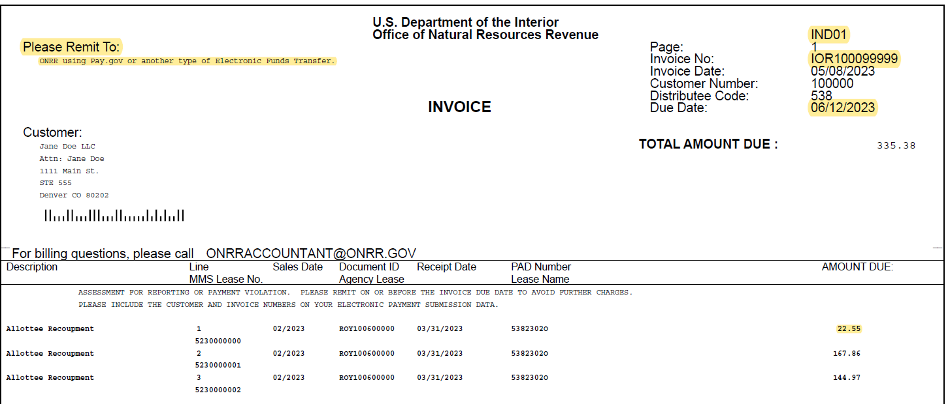
Bill Page for IOR Invoice

Slide 54
Schedule Page

Slide 55
TRIBAL RECOUPMENT

Slide 56
30 CFR 1218.53, Paragraph (b)

Slide 57
Recoupments against Tribal Leases Example 1 of 3
Criteria
Must provide written Tribal Permission to ONRR
Same Payor
RVLA can be zero or positive
Indian Net Negatives go through a stringent approval process
Highly recommended reporting Recoupments against other Tribal Leases on separate 2014, not with other or monthly reporting

Slide 58
Recoupments against Tribal Leases Example 2 of 3 - 2014 Reporting

Slide 59
Recoupments against Tribal Leases Example 3 of 3 - Interest

Slide 60
Major Portion Pricing (MPP)
30 CFR 1206.174

Slide 61
Indian Gas Major Portion
Leases not located within
an Indian Index Zone
Leases within an Index Zone but have an arm's-length dedicated sales contract
Leases with a major portion provision or language providing the Secretary of the Interior with the discretion to determine value.
Leases which are allotted leases in the Navajo Nation

Slide 62
Major Portion Pricing (Indian Gas Only)
Report adjustments to published major portion price and/or dual accounting for Indian gas production for 01/2000 sales forward
Adjustment Reason Code 16 applicable
Very important! Use ARC16 on both the reversal line and the rebook line

Slide 63
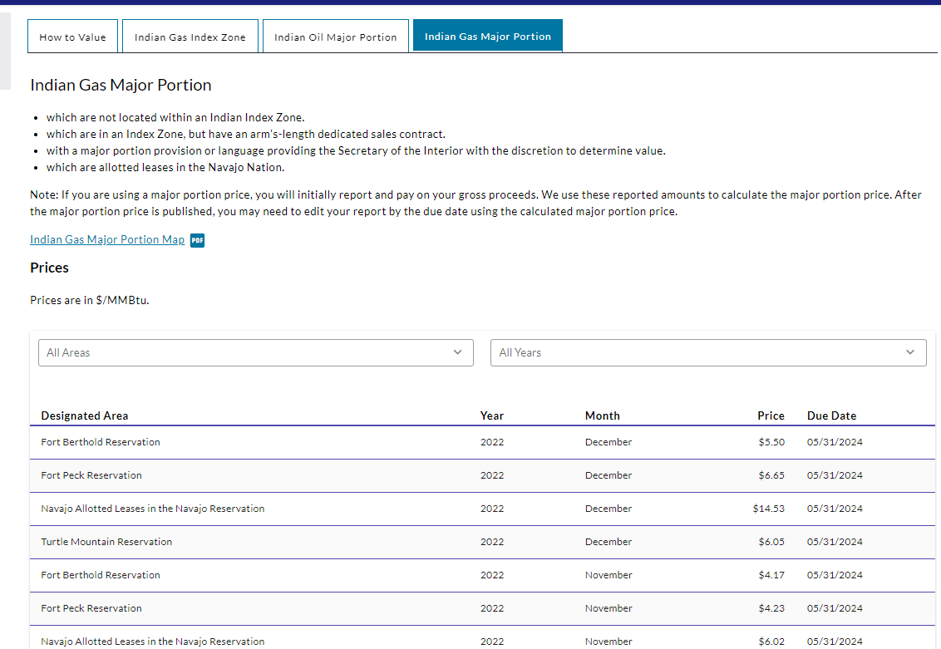
Major Portion Pricing (ARC 16)

Slide 64
Major Portion Pricing (ARC 16) Interest
Sales Date 01/2018 due 10/31/2020 (Saturday)
Due Date extended to 11/02/2020 (Monday)
Paid 03/17/2021
Interest due 11/02/2020 – 03/17/2021

Slide 65
Review - Indian Portion
INDIAN LEASE RENT
Remit on 2014 - Rent, Minimum Royalty, Well & Storage fees, Advanced Rent
RULES FOR
INDIAN 2014 RECOUPMENTS
Tribal Leases - 100% against current revenue
Allotted Leases - 50% of current revenue
IOR INVOICE
Issued when too many negative adjustments are taken against current revenue
TRIBAL RECOUPMENTS
Must provide written Tribal permission to ONRR
MAJOR PORTION PRICING
Only Indian Gas (Specific index zones)
Price published per calendar year with specific due dates

Slide 66
Supplemental Actions
ONRR Accountant: All billing matters should be discussed with the issuing accountant. Many questions/concerns can be handled by the accountant.
Appeals: If the matter is still unresolved, the company should begin exercising their appeal rights within the allotted time frame. If an invoice is an appealable action, appeal rights with appeal instructions should have been received with the invoice. For more information concerning appeals, including your rights and instructions for filing an appeal, please visit ONRR.gov.

