Slide 1
Reporter Online Training Housekeeping
All participants will be muted upon joining the training due to the large class size.
Please use the Audio heading at the top of the screen to test your speakers or headset. If you do not hear anything or do not have speakers, please click Audio – Audio Conference and follow the “Use Phone” instructions to listen via teleconference. Phone users, please mute yourselves upon entry.
Please use the WebEx Question and Answer feature to ask any questions. This feature is located at the top-right corner of the screen and says Q&A with a question mark. Please make sure to select “All Participants” when asking a question.
Please use the Chat feature for technical issues and select “All Panelists” in the dropdown. This will get you a faster response.
We will be using a closed captioning service during our Webex trainings. Please dropdown the multi-media feature or select the multi-media feature to view the closed captioning.

Slide 2
Federal and Indian
Adjustments

Slide 3
Outline
Overpayments vs over-reporting
Refunds
Recoupment rules (allottees vs tribal)
Recoupment Edits
Notes:
In this presentation we will discuss overpayments versus over reporting, Refunds, Indian Recoupment Rules and the Recoupment edits.

Slide 4
Reversal and Re-book
Two – line entry required
  Reverse the original line as accepted into the ONRR financial system
  Enter the correct (re-book) line. Adjustment Reason Code (ARC) required on both lines.
  Reversals and Re-books are not required for estimate adjustments.
Notes:
The first thing to note when you are making an adjustment is that it requires a two-line entry.
The first line should be your reversal line which will exactly match the line you are reversing from history but with negative volumes and values. The 2nd line will be your new re-book line with your corrected information.
Make sure that both lines have an adjustment reason code.
Reversals and re-books are not required when reducing or adjusting an estimate.

Slide 5
Rolled up Reporting NOT Allowed
ONRR does NOT allow rolled up reporting.
Example of rolled up reporting
  Payor reports a line for 100bbls, but later realizes it should be 110bbls, so the Payor sends a new 2014, 1 line, reporting the difference:
  Volume: 10.00 Value: 400.00 RVPA/RVLA: 40.00
Minerals Revenue Reporter Handbook, 6.1.1: “We do not allow single-line adjustments (net adjustments) unless we authorize them in advance.”
  ONRR does not authorize this, except for extremely rare circumstances
Notes:
ONRR does not allowed rolled up reporting as shown in the example. In this example the payor discovered that the original volume reported was incorrect. They will need to reverse the original line and rebook with the corrected information, they cannot just come in the with additional volumes.
ONRR will not allow single line adjustments except for extremely rare circumstances.

Slide 6
Adjustment Reason Codes
10 Adjustment
      Unless instructed otherwise by ONRR, industry can report volume, value, and royalty rate adjustments using ARC 10. This includes Compliance requests.
16 Major Portion/Dual Accounting (post 01/01/2000)
      Indian Only
17 ONRR-Initiated Compliance Adjustment (CMP2014 Only)
32 Estimate Adjustment
35 Unit Participating Area/Communitization Agreement Adjustment
49 Index Zone/Dual Accounting Price Adjustment
(post 01/01/2000 sales months only)
      Indian Only
Notes:
These are the most common Adjustment reason codes for the Form ONRR-2014. The most common ones we see are 10 (adjustments the payor initiates or Compliance Management), 17 (Audit Adjustments), 32 (Estimate Adjustments), and 35 (CA/PA Adjustments). If you want a full list of the adjustment reason codes, you can find the list in the Reporter Handbook. If you are looking at your history and see one that is not listed in the handbook, please contact your royalty analyst. Not all codes are listed because some are used internally for accounts receivable and royalty.
For more information on Adjustment Reason Codes, See the Minerals Revenue Reporter Handbook, Appendix F, Adjustment Reason Codes.

Slide 7
CMP’s
ARC 10 can not be used
ARC field can not be blank
If an estimate was reported on a report being reversed, they should not include it in the reversal
All lines submitted should be reviewed
Notes:
CMP’s are reports submitted at the request of an auditor. You cannot report your audit adjustments along with your regular monthly royalty reporting on a CMP. The only adjustment reason codes you can use are 16, 17, 35, 49. You cannot use ARC 10. and you cannot leave the ARC field blank.
You cannot adjust an estimate on a CMP. Our system will not allow an ARC 32 on a CMP.
If you require an override on a CMP document, your royalty analyst will send the lines to the auditor for approval to override them.
Your auditor will review all lines submitted before releasing them.

Slide 8
Recoupment Situations
Overpaid- Reported Royalties Correctly
  No adjusting Form 2014 necessary
  Use credit toward the payment of the next amount due to any lease. Indian can only credit an Indian Lease with that distributee code.
  Please notify your assigned ONRR Accountant
Overpaid on a tribal lease (PM 07)- Reported Royalties Correctly
  No adjusting Form-2014 necessary.
  Use credit only to reduce future payments to that specific tribal lockbox.
  Please notify your assigned ONRR Accountant.
Notes:
Next we are going to go over some recoupment situations.
The 1st one will be overpaid but royalties were reported correctly. This is a case where the royalties were submitted correctly on the Form 2014, but the Payment was incorrect.
You will not need to submit a correcting Form 2014
If there is a credit you can contact your ONRR Accountant and let them know where to apply your credit. If you need to know who your Accountant is, you can find the listing on ONRR.gov. This is not the same person as your Royalty Analyst.
If you have a credit on an Indian Lease, you can only credit an Indian lease with the same Distributee code that the payment was submitted under.
The 2nd will be Overpaid on a Tribal lease but royalties reported correctly.
You will not need to submit a correcting Form 2014
If there is a credit you can contact your ONRR Accountant and let them know where to apply your credit. The Accountant for your Indian leases is different than the accountant for your Federal leases.
You can only credit an Indian lease to reduce future payments to that Specific Tribal lockbox.

Slide 9
Recoupment Situations (cont.)
Overpaid AND Over-Reported Royalties
  Must reverse original entry and then rebook with correct data.
  Use Federal credit toward the payment of the next amount due to any lease.
  Indian must establish recoupable balance for the specific Indian lease (s) in which the error(s) occurred with a transaction code 50.
    Once a Transaction Code 50 (TC 50) is established, recoup with a TC 51 against net current revenue due on the same lease until fully recouped.
Notes:
The next situation we are going to cover is overpaid and over-reported royalties. This is where the Royalties were over-reported on the Form 2014 and the payment matched the Royalties due on the report.
You must do a two-line reversal and re-book to correct the data like we discussed in previous slides..
You can use a Federal credit toward the balance due on any lease.
If you have over-reported on an Indian lease you must set up a recoupable balance using a 3rd line with a transaction code 50, and you can recoup it the following month using a line with a transaction code 51. This is lease specific and can only be recouped on royalties paid for that lease. We will cover recoupable balances in later slides.

Slide 10
Making an Adjustment Resulting in an Overpayment
Recoupment
ONRR prefers that overpayments are recouped: correct the overpayment on a new positive 2014 report.
Example: 03/2018 was Overpaid, and you are getting ready to submit the
07/2020 ONRR-2014.
03/2018: -$500
03/2018: +$300
07/2020: +$600
Send payment for the difference: $400
Saves time and money versus establishing a credit/refund!
Exception: Audit and Compliance adjustments must be sent separately.
Notes:
This is an example of making an adjustment resulting in an overpayment. ONRR prefers that you do your adjustments along with other Royalty reporting versus establishing a recoupable balance. Instead of sending a negative 2014 (which creates a credit), many adjustments can be combined with a new/positive 2014 to simply reduce what is owed.
This saves time and money (human resources) versus establishing and tracking credits/refunds.
The first 2 lines of the document in this example is your March 2018 reversal/re-book. The 3rd line is the Current reporting for July 2020. In this case the July 2020 Royalties due is more than the reversal/rebook so the payor would pay the difference.
Exception: Audit adjustments must be sent on the CMP-2014. Compliance requests shouldn’t be combined with monthly reporting – if an Override is required, this may slow down the approval process (and then the monthly reporting may be late).

Slide 11
Indian Net Negative
Payors cannot submit reports with Edit 9748 – “Indian Lease Less than Zero” unless they are reversing a report that has not been paid or money has not been disbursed.
Payors must set up a recoupable balance (TC50).
There are no regulations that state a payor cannot use a recoupable balance (TC51) towards monies owed ONRR if they have current revenue to recoup against.
Notes:
When payors are adjusting reporting and the reversals are more than the re-books and you are not combining with regular reporting, you will need to set up a TC50 even on a CMP document. We cannot override this error.
The only way we could override this error is if you are reversing a whole document that has not been paid or the money is at ONRR and has not been disbursed.
If payors are making corrections on a CMP and they owe money to ONRR and have recoupable balances that have been previously established, there is nothing in the regulations that states you cannot use the balances towards the money owed if they have current revenue (Positive PPAs) to recoup against.

Slide 12
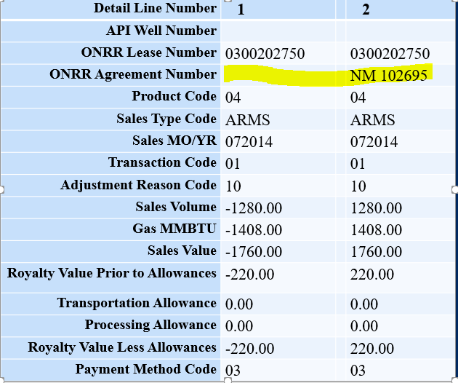
Making an Adjustment that Does
NOT Affect Royalties
Notes:
Example: Payor sent 2014 reporting to the lease only, when it should have been reported to the lease + agreement. The volumes/values in this example did not change.
First Step: Go to the Data Warehouse and find the original line (do not use your own history).
Second Step: Reverse your original line using the appropriate adjustment reason code.
Third Step: Rebook your line ensuring that you use the same adjustment reason code as your reversal line.

Slide 13
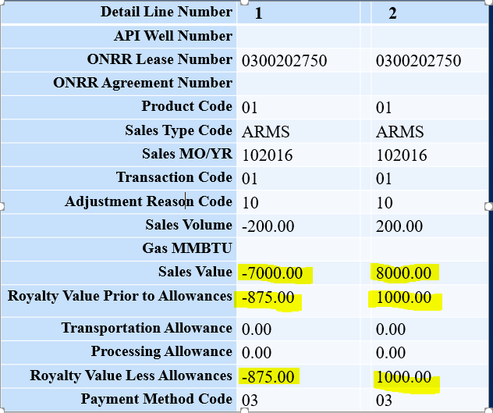
Making an Adjustment Resulting in Additional Monies Owed
Notes:
Example: Increasing the price of reported oil. This results in a higher Sales Value and therefore a higher Royalty Value.
First Step: Go to the Data Warehouse and find the original line (do not use your own history).
Second Step: Reverse your original line using the appropriate adjustment reason code.
Third Step: Rebook your line ensuring that you use the same adjustment reason code as your reversal line.
Fourth Step: Send the additional payment due: $125.00.

Slide 14
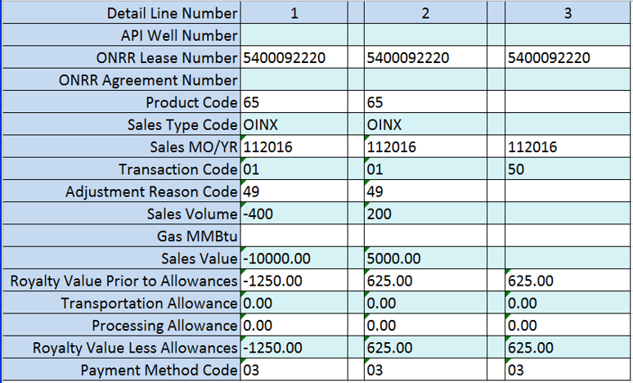
Making an Adjustment resulting in an Indian Overpayment
Notes:
Example: Reducing the Sales Volume reported. This results in a lower Sales Value and therefore a lower Royalty Value.
First Step: Go to the Data Warehouse and find the original line (do not use your own history).
Second Step: Reverse your original line using the appropriate adjustment reason code.
Third Step: Rebook your line ensuring that you use the same adjustment reason code as your reversal line.
Fourth Step: Establish a recoupable balance using TC50 for the overpayment.

Slide 15
Overpayments/Refunds
ONRR prefers overpayments be addressed by recouping or establishing a credit (to use against future reported revenue).
ONRR CANNOT REFUND Indian payments. If there is no new revenue:
  Allotted leases- refund not possible
  Tribal leases- company must request from the appropriate tribe. ONRR will not request a refund on your behalf.
When a lease is sold or acquired, it may be possible to transfer the recoupable balance between Payors.
Notes:
ONRR cannot refund Indian payments; therefore, be very careful when you report and pay Indian leases.
Overpayments that were also over-reported are corrected by establishing a recoupable balance (TC50) in the amount of the overpayment. Then, you can recoup those overpayments against net current revenues (TC51).
NOTE: If you are going to transfer Indian estimates or recoupable balances, you must contact your Royalty Reporting analyst to perform this action for you. Reporters/Payors are not allowed to transfer the balances. There are procedures that we must follow for this to be accomplished.

Slide 16
Indian Recoupment Rules
Tribal
Under protection of Indian Tribe
TC 50/51
Recoup up to 100% of net current revenues
Lease specific
With written permission from the Tribe, may recoup from other tribal leases
Allotted
Owned by an individual Indian
TC 50/51
Recoup up to 50% of net current revenues
Lease specific
Notes:
Let’s look at the difference between tribal and allotted lease Recoupment procedures.
Tribal: The payment is disbursed to the tribe. If you overpay a tribal lease, you can set up a recoupable balance (TC 50) and recoup against current revenue using (TC51). You can recoup up to 100% of net current revenue against the same lease as the overpayment. If you overpay a tribal lease and are unable to recoup the balance, you can request permission from the tribe to recoup the balance from other tribal leases.
Allotted: The payment is disbursed to an individual allottee; therefore, the recoupment is prorated so that the current revenue is not reduced by more than 50 percent – you can recoup up to 50% of net current revenues. If you overpay an allotted lease, you can set up a recoupable balance (TC 50) and recoup against current revenue using (TC 51) on the same lease as the overpayment. If you overpay an allotted lease and are unable to recoup the balance, you will not be able to get a refund.
Note: Keep track of your recoupable balances by payor code and lease number. If you try to recoup more than the balance, the line will reject.

Slide 17
Current Revenues
What are “Current Revenues”?
Royalty owed for the current report month, as well as:
All other lease revenues reported in the same month, such as annual rent and positive adjustments to previously reported sales months, less recoupment (TC25) of the current lease year’s advance rental payment.
Notes:
Current revenues are Royalties owed for the current report month as well as annual rents and positive prior period adjustments less recoupment of the current lease years advance rental payment (recoupable rent).

Slide 18
Current Revenues (cont.)
What does that really mean?
Current revenues being reported, such as reporting 12/2021 sales at the end of 01/2022, unless there is an estimate in place. Royalties would then be due 2/2022.
Prior Period Adjustments (PPAs) are calculated per Sales Dates. This means if a PPA is positive (if that month was originally underpaid), then that month’s total is part of current revenue.
Advance Rental payments (TC05) are not considered overpayments, so the recoupments (TC25) are not part of current revenue.
Notes:
What that means is royalties being reported for December 2021 at the end of January unless you have an estimate which would give you until the end February. Any prior period adjustments in which you owe ONRR.

Slide 19
Indian Allotted Example:
Lease number is 1234567890
Report is being completed on 04/30/2021
The lease has an estimate on file for $26,000.00 for this payor code
Recoupable Balance is $50,000.00
Current Rent was paid last month for $750.00 and $750.00 is left to recoup
Current Production is for 02/2021 RVLA is $6,250.00
A Prior Period Adjustment is being made for Sales Month 05/2017. Adjustment will increase royalties due by $11,500.00
Notes:
We are going to go over this example in the next slide.
In this example we will be making positive prior period adjustments and doing a recoupment.

Slide 20
Indian Allotted Lease
Scenario Breakdown
Notes:
This is a great example for an allotted lease that will aid in you in reporting correctly.
The first two lines are a reversal/re-book of a prior period which gives us new revenue of $11,500.
The next line is the regular monthly revenue which is $6,250. This now gives us a total of 17,750 current revenue to recoup against.
You can then recoup this year's recoupable rent against this revenue. Since Recoupable rent is not considered revenue, it does not follow the recoupment rules which is why we suggest you recoup your full rent if possible before recouping any other balances. In this case, the rent was $750.
This now leaves us with total revenue of 17,000. 50% of that total revenue would be $8,500. This is the balance that you can either reduce your estimates against or recoup from your recoupable balance. In this case we reduced the estimate by $3,000 and Recouped $5,500 from the Recoupable Balance. The payor would now pay the remaining balance of $8,500.

Slide 21
Recoupment Edits
9580: “Recoupment not possible, insufficient summed amount.” Covers TC03 Estimated payments
9765: Recoupment not possible; summed amount greater than Recoupment Balance for TC04.
9766: Recoupment not possible; summed amount greater than Recoupment Balance for TC05/TC25.
9767: Recoupment not possible; summed amount greater than Recoupment Balance for TC50/TC51.
Notes:
These are the edits we now have in place regarding Recoupments. I will explain how these edits work on the next page.
9580 – This edit relates to estimated payments (TC03)
9765 – This edit is for Non-recoupable rents (TC04).
9766 – This edit is for Recoupable rent (TC05) and the recoupment of that rent (TC25)
9767 – This edit is for Recoupable balances (TC50) and the Recoupment (TC51)

Slide 22
Recoupment Edits (cont.)
What do these edits do?
These edits total up the appropriate lines (based on lease, TCs, and dates when applicable).
If positive subtotal, the edits will not trigger.
If negative, that subtotal is compared to the LAB balance. If the negative subtotal exceeds the LAB balance, edits will trigger.
Note: These edits will only appear once in Validation Results, not on all lines.
Notes:
These edits total up all lines with that transaction code based on lease, and dates when applicable. If the result is positive the edit will not trigger. If the result is negative that total is then compared to your balance in LAB and if it is still negative will trigger.
Note: Because of how the Edits work (summing up totals throughout the report), The Validation Results window will only display the error once per “summed totals” (so, Rent may display more than once if multiple lease years have problems).
*****If you get one of these errors you will need to check your whole document to check your totals.

Slide 23
Large Reports
2014 reports are limited to 49,999 detail lines
Payors should be able to have just as many errors on their reports and should no longer have to break them up into multiple reports.
Reversals and rebooks should be on the same report
Notes:
You are allowing 49,999 lines on a Form 2014. You will also be allowed the same number of errors. If there are multiple errors on 1 line you will have to break up your reports accordingly. Always make sure that your reversals and re-books are on the same report. This will have financial consequences if you do not, and I will discuss that on the next slide.

Slide 24
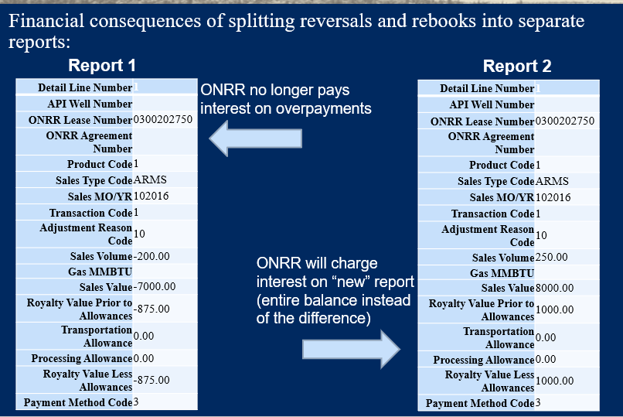
Large Reports (Con’t)
Notes:
When reversals are on a separate report the report zeros out that timeframe since the report shows negative. Once the new positive report is submitted our interest module will look at the new report as a brand-new report and will charge interest from the date it was originally reported, even when the ARC is reported.
If you have a larger report that needs to be broken up, please separate by sales month so your reversals and rebooks stay together on your report.

Slide 25

Thank you!!!
We will leave the chat open for a few more minutes for any additional questions you may have.
Notes:
We will leave the chat open for a few more minutes for any additional questions.

